Slide 1
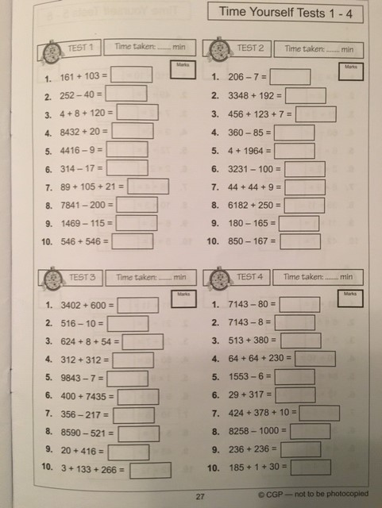
Time Yourself Tests 1-4

Slide 2
