Slide 1
Suggested English plan for this week:
Spellings to learn: beautiful, happiness, angrier, prettier, readily, dried, defied, applies, silliness, heavier
Reading - a school library book or a book from home. Don’t forget to record when you read in your reading record. Can you write a book review to recommend your book?
Grammar – Complete a couple of the Classroom Secrets grammar tasks
Monday:
Grammar – workout week 12
Nouns and expanded noun phrases ppt and activity
Tuesday:
Write a paragraph to include noun phrases and prepositions to describe the UFO picture.
Wednesday/Thursday:
Newspaper report
Friday:
Reading comprehension (fiction/non-fiction/poetry)
Yr 4 – Cats/It couldn’t be done/Snowball and Ebony
Yr5 – Phone trouble/Lightning/Written in March

Slide 2
Monday Nouns and Simple noun phrases
Nouns
Simple noun phrases
Nouns - person, place, thing (concrete or abstract) or animal
Simple noun phrases are groups of words, including a noun, that make up part of a sentence.
The noun is the main word in the phrase and other words give information about it.
alien
noun
The alien
determiner
noun

Slide 3
Adding Adjectives
Expanded noun phrases
You add adjectives after the determiner to make an expanded noun phrase
Expanded noun phrases give more detail than a simple noun phrase.
This adds extra detail about the noun.
The small, green alien
Determiners are placed before the noun and help to describe it.
determiner
noun
adjectives

Slide 4
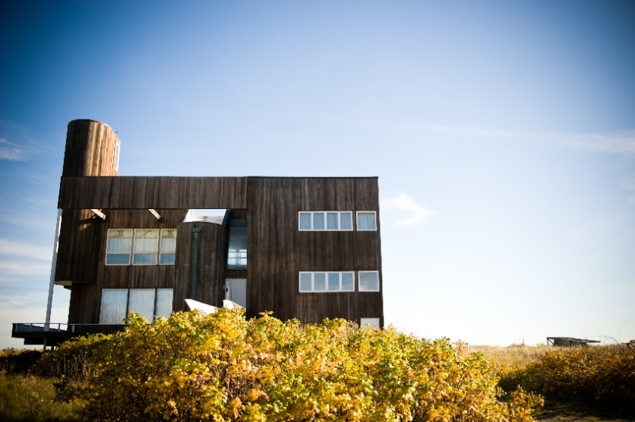
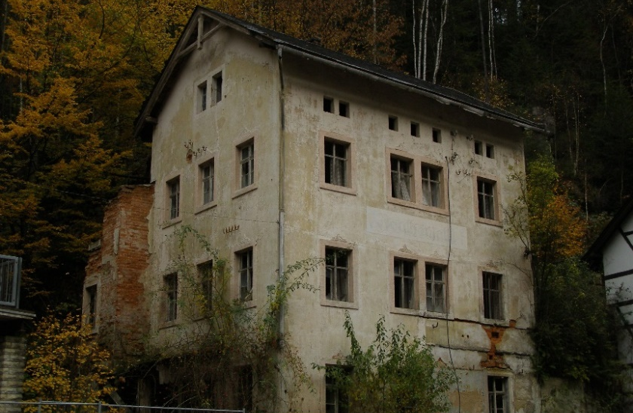
Adjectives for Effect
The adjectives we choose to expand the noun phrase can create very different effects.
Simple noun phrase – a house
We could see a bright, airy house on top of the hill.
We could see a dark, gloomy house in the forest.

Slide 5
Add adjectives and prepositions to
these simple noun phrases.
A planet
The rocket

Slide 6
Add adjectives and prepositions to create an expanded noun phrase for the following simple noun phrases:
A planet (eg A bright green planet was spinning in the sky.)
The rocket (eg The rusty old rocket landed clumsily in the pond.)
Challenge: Look around the room you are in and think of a simple noun phrase (eg the cat, the sofa, five apples, my brother etc). Can you add adjectives and prepositions?
Task

Slide 7
Tuesday
Task
Can you write a descriptive paragraph about the UFO
picture using expanded noun phrases?
Hint: what can you see? Stars, trees etc
Remember: capital letters, full stops, interesting verbs. Check that your sentences make sense!

Slide 8
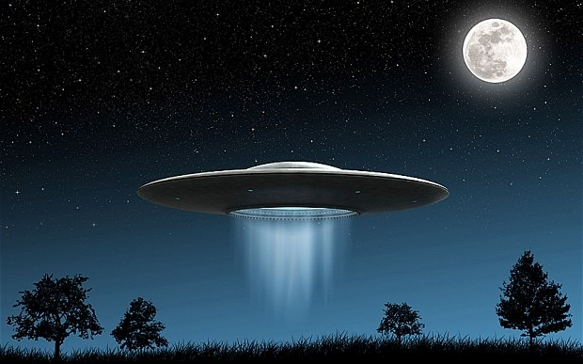

Slide 9
Wednesday/Thursday
Plan and write a newspaper report about anything!
Look at your local paper or an online newspaper for inspiration.
Think of a story that interests or inspires you (real or made up!).
Plan first and then write up your report.
Write in chronological order.
Keep your reader interested – reveal the action.
Use interesting expanded noun phrases and prepositional phrases.
Don’t forget to include a quote and a picture.
Role-play a news room where you are a local news reporter (get your parents and/or siblings involved!). Make a microphone?

Slide 10
Example
headline
School Children Raise Funds for Local Charity
Frances Trackall, Education reporter
A small group of Year 5 students from Arkwood Primary School have created a brilliant plan to raise money for a local charity that assists people in the community. Following a visit to the school from a charity representative, the students set out to create a way of raising much needed funds.
The students presented the fundraising idea to school principal Mrs Justine Knight, who saw great potential in the plan to sell produce from the school’s vegetable garden to local restaurants and, in turn, raise money for the local charity. She stated that ‘the children have displayed a true sense of community in their fundraising plan.’ Following a meeting with teachers, it is hoped that the students can begin to implement the four phase plan. ‘The school would support students wholly in the fund raising venture,’ Mrs Knight added.
The school plans to sell the garden produce to two local restaurants, beginning in early September. For more information on this fundraising plan, visit the Arkwood Primary School website (www.arkwood.sch.com).
byline
Introduction
body
conclusion

Slide 11
Get It Right!
For a GREAT newspaper report you need to:
Keep your most important information near the top of the report;
Cut out the less important sections from the bottom of the report if it ends up being too long;
Keep your sentences short and punchy, so that the report is interesting to your reader;
Check your spelling and your facts…and check them again!

Slide 12
Friday
Reading comprehension
Year 4 and Year 5 comprehensions will be uploaded onto the website.
Choose one or the other or perhaps have a go at both!

