Slide 1
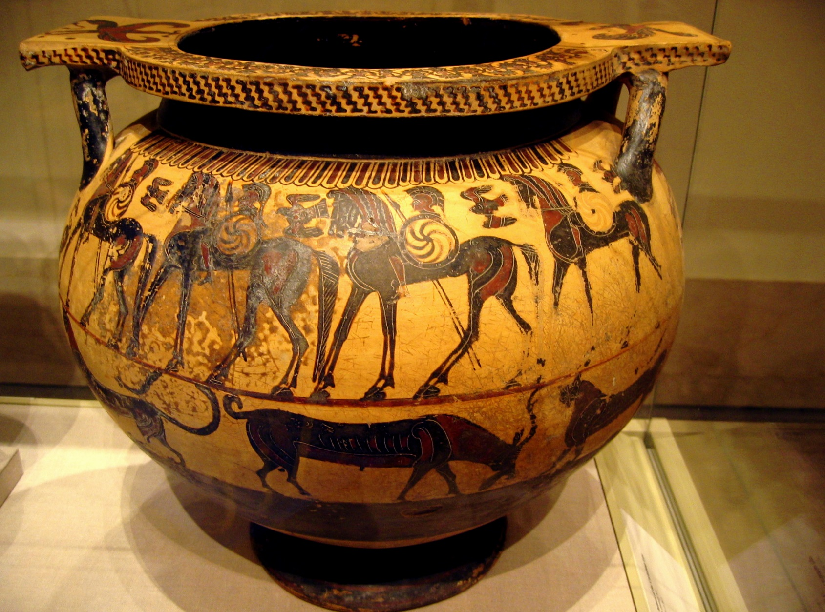
Photo courtesy of Casbr(@flickr.com) - granted under creative commons licence - attribution

Slide 2
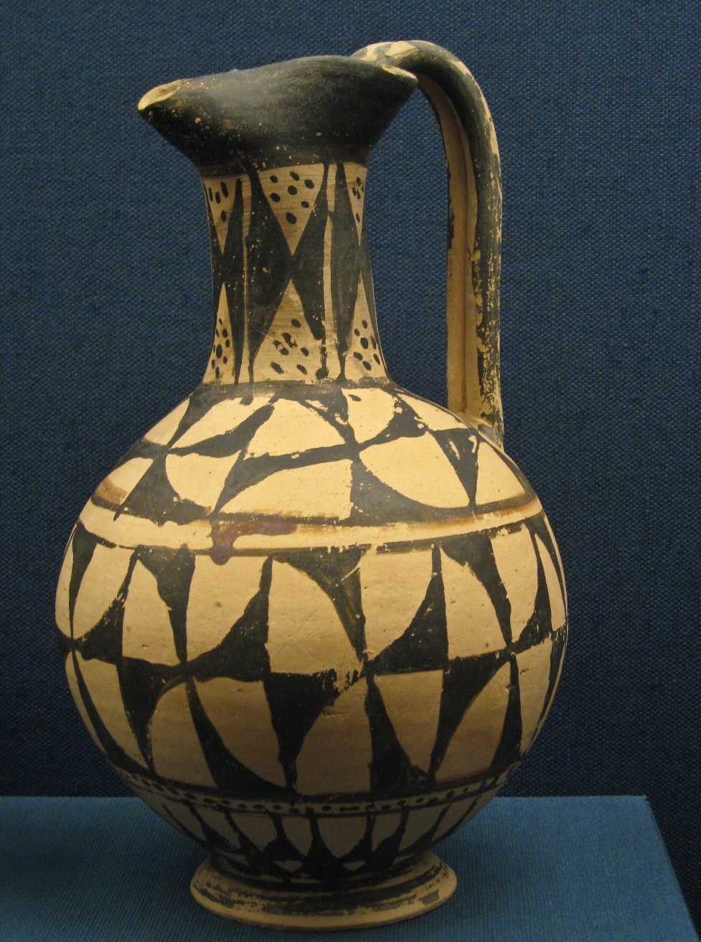
Photo courtesy of Sharon Mollerus(@flickr.com) - granted under creative commons licence - attribution

Slide 3
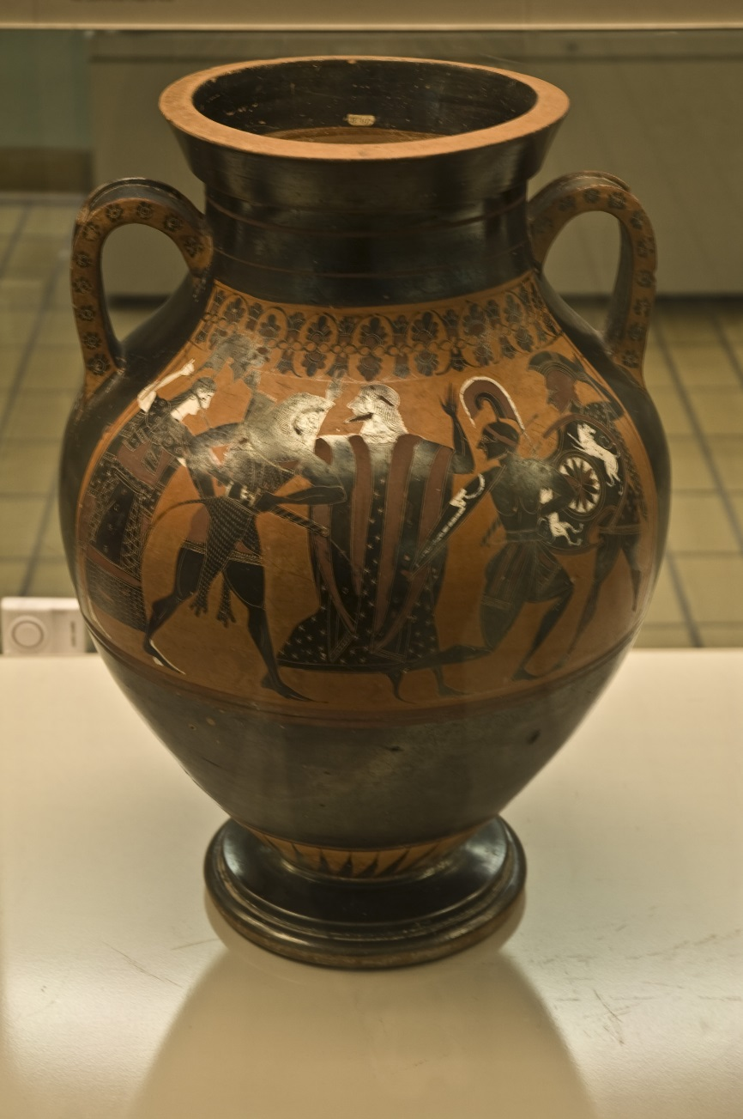
Photo courtesy of Gaspa(@flickr.com) - granted under creative commons licence - attribution

Slide 4
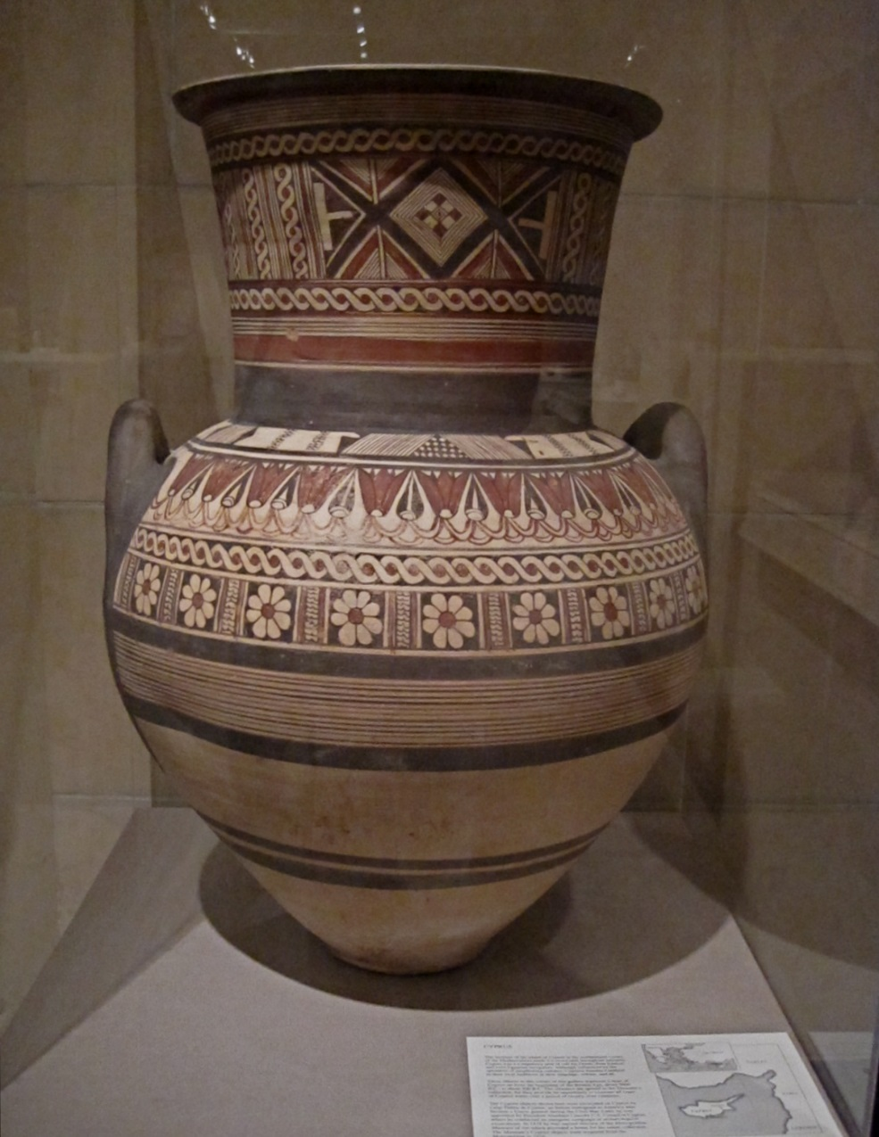
Photo courtesy of ellenm1(@flickr.com) - granted under creative commons licence - attribution

Slide 5
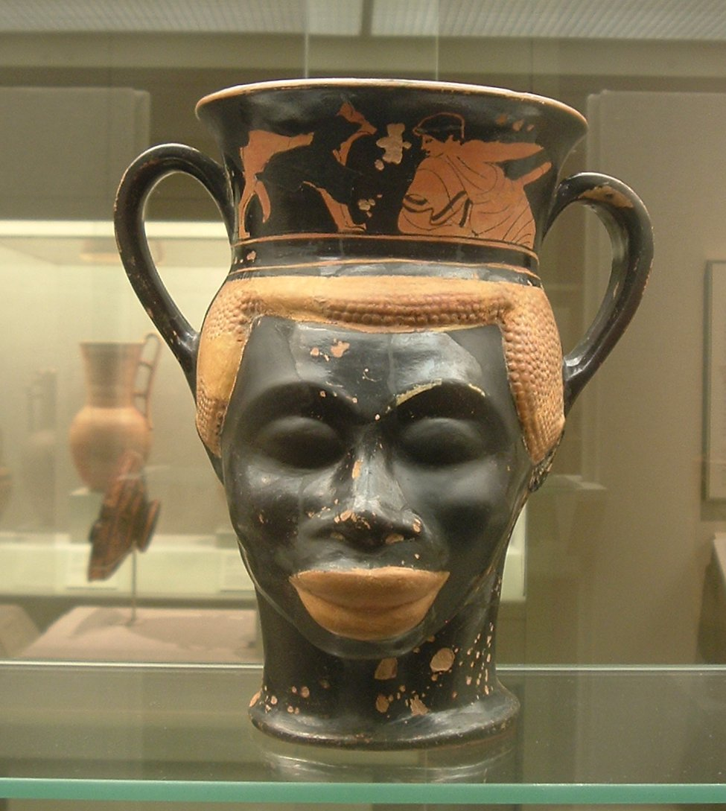
Photo courtesy of Gruenemann(@flickr.com) - granted under creative commons licence - attribution

Slide 6
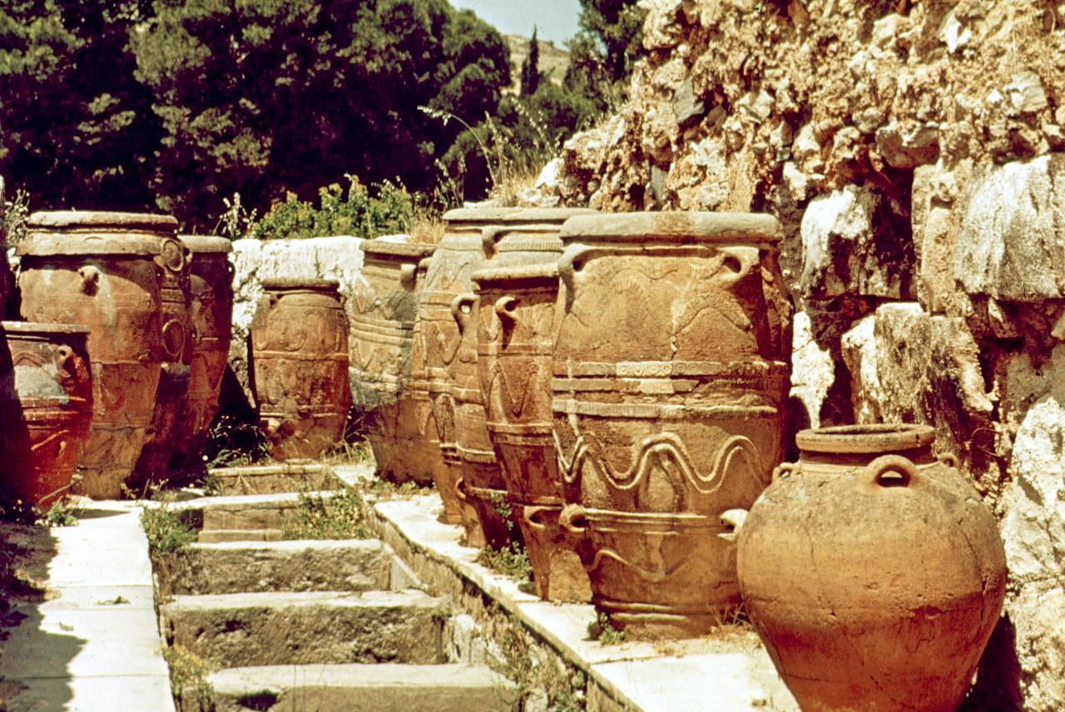
Photo courtesy of serendigity(@flickr.com) - granted under creative commons licence - attribution

Slide 7
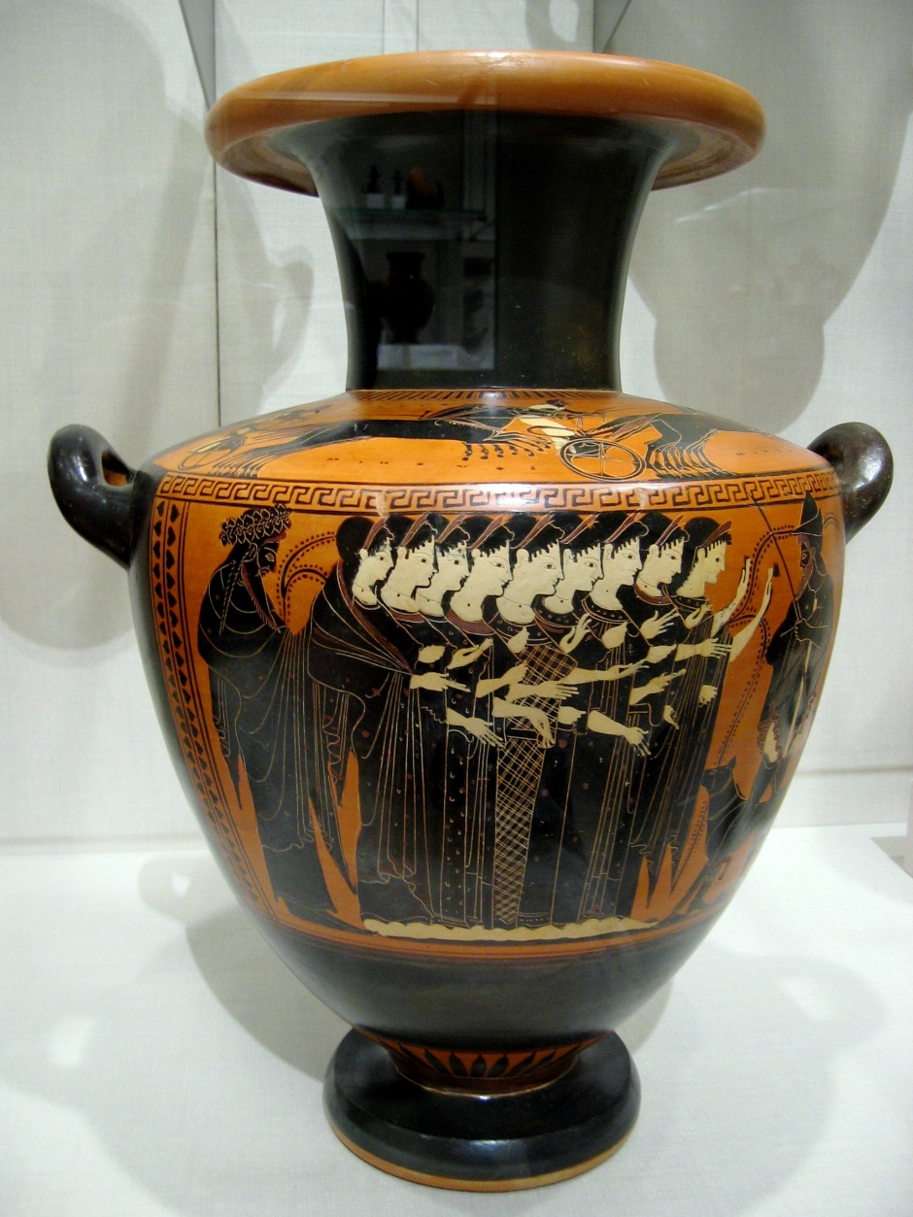
Photo courtesy of casbr(@flickr.com) - granted under creative commons licence - attribution

Slide 8
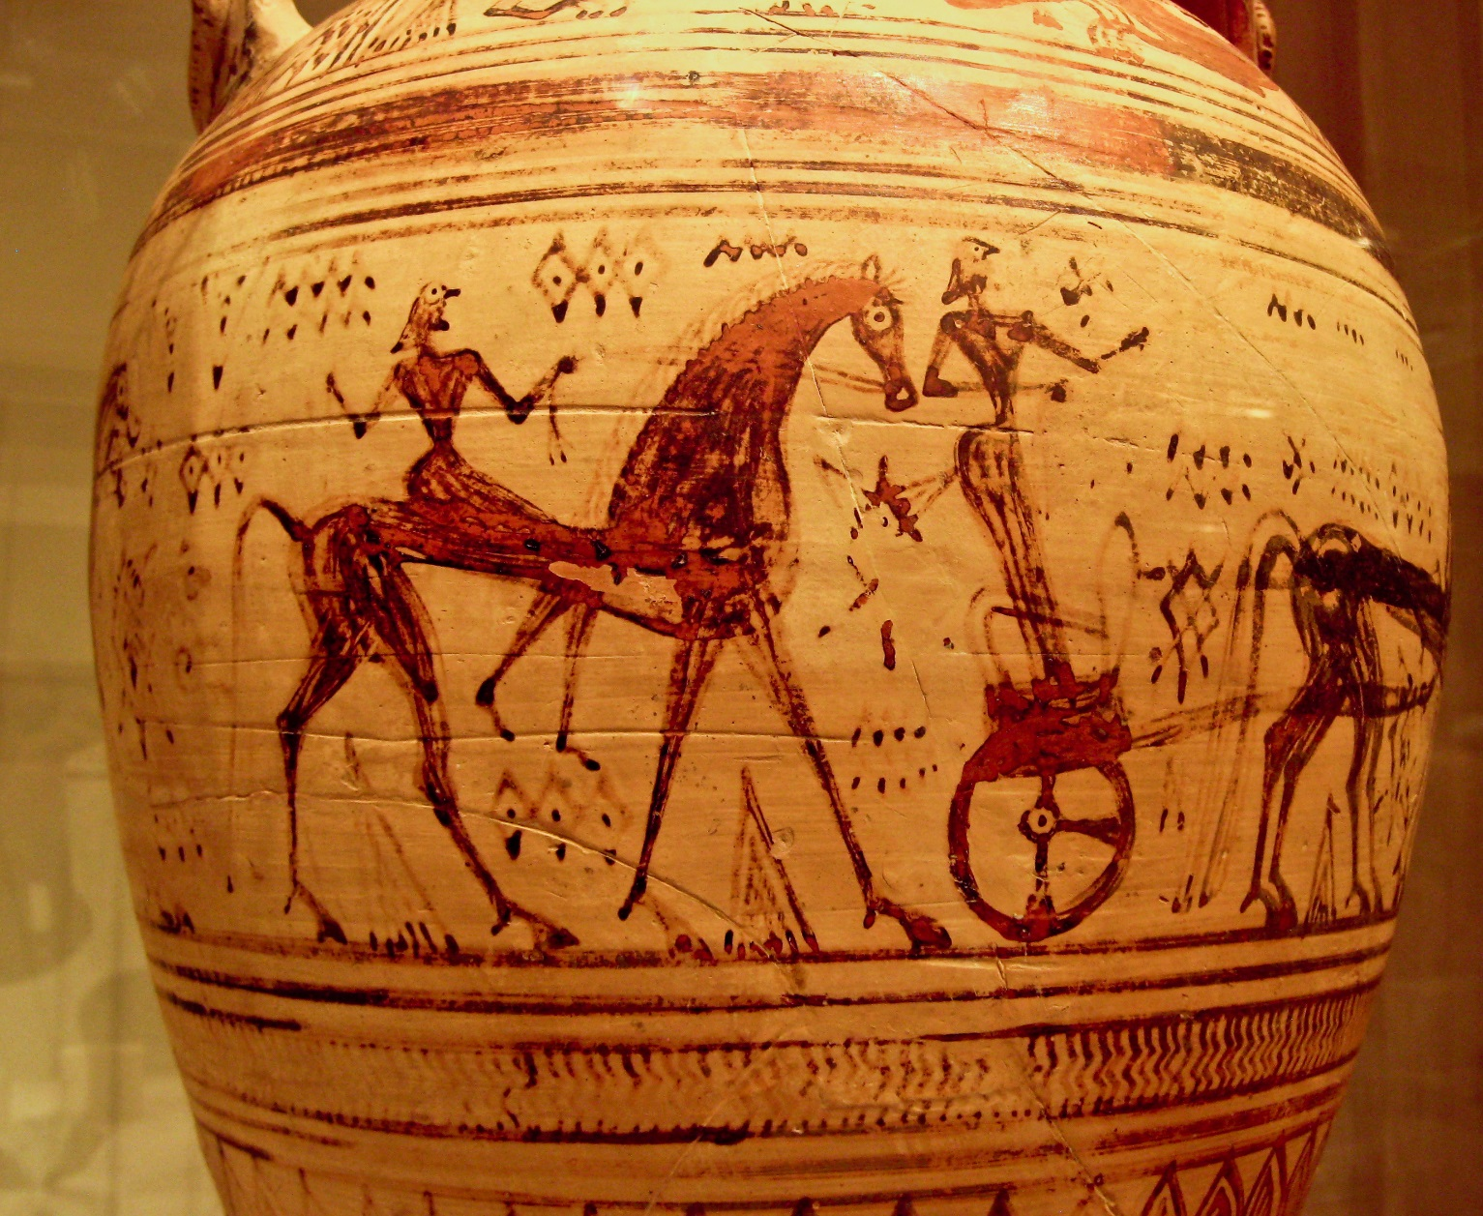
Photo courtesy of Sharon Mollerus(@flickr.com) - granted under creative commons licence - attribution

Slide 9
THE END

