Slide 1
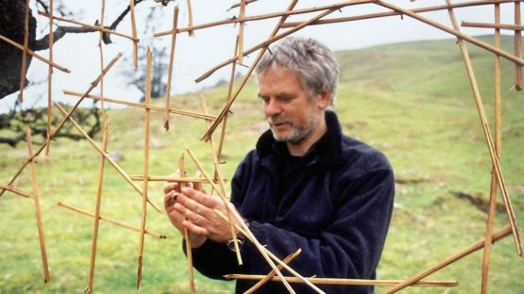
Andy Goldsworthy
Andy Goldsworthy is an artist who likes to use natural materials. He is not a painter, he is a sculptor.

Slide 2
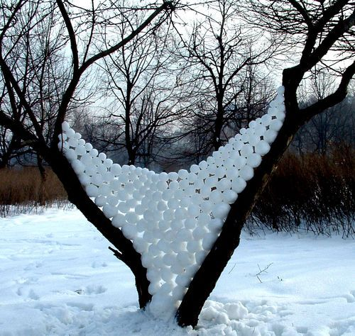
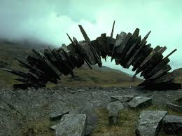
Andy Goldsworthy was born in 1956.
He lives and works in Scotland.

Slide 3
How do you think Andy Goldsworthy made this beautiful picture?
Notes:
What materials did he use? How do you think he made the black circle in the middle?

Slide 4
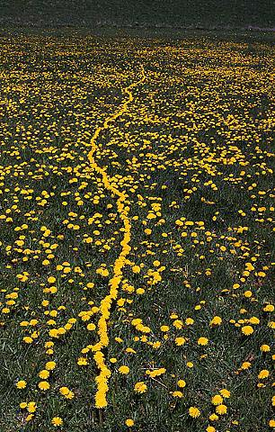
How does he record his work?
Notes:
What do you notice about this picture?

Slide 5
Notes:
What do you think this is made from? How has he made such a pretty effect with the pebbles?

Slide 6
How did Andy Goldsworthy make this swirly pattern?

Slide 7
What do you think of his work?
Notes:
Cn you guess what this is made from? Can you guess how he made it?

Slide 8
