Slide 1
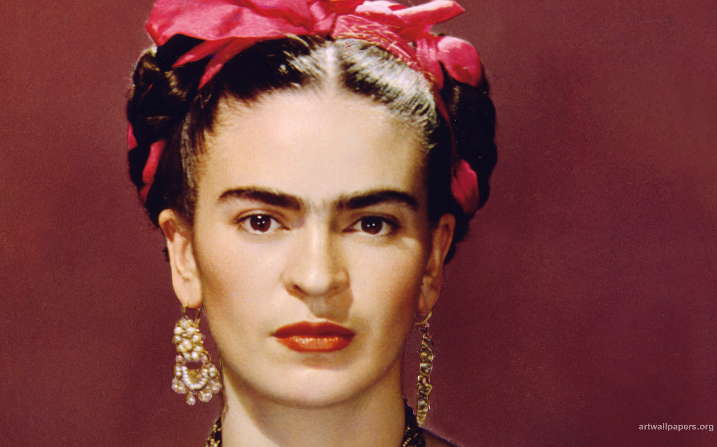
Frida Kahlo
1907-1954

Slide 2
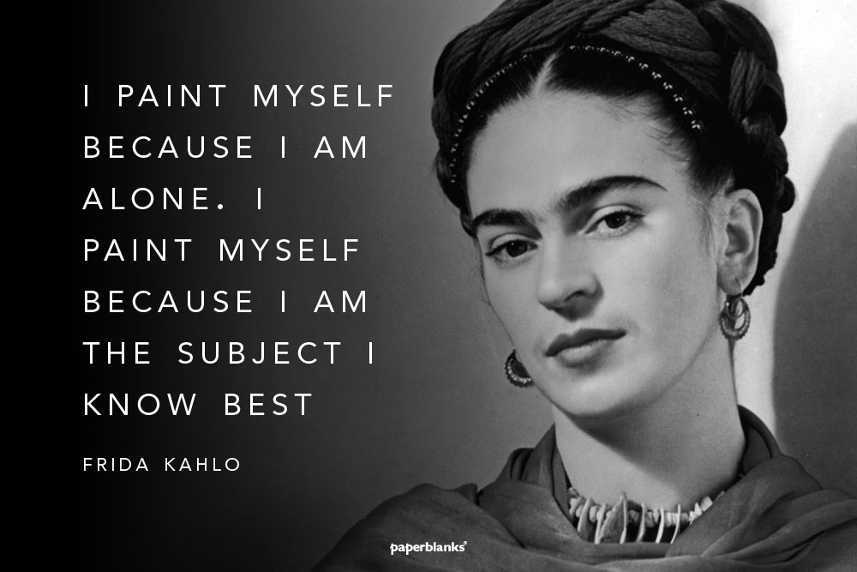

Slide 3
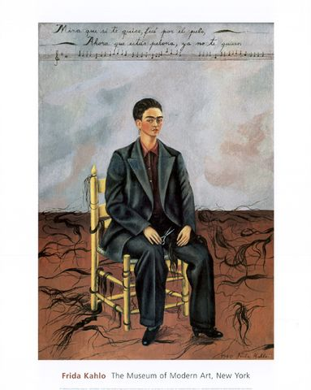
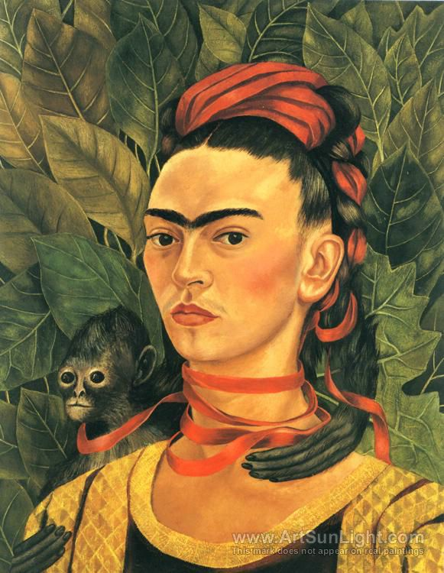
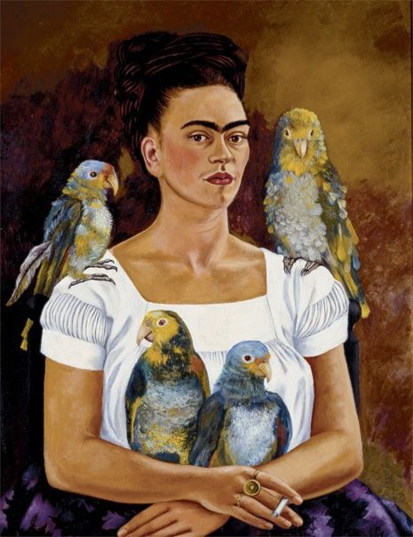
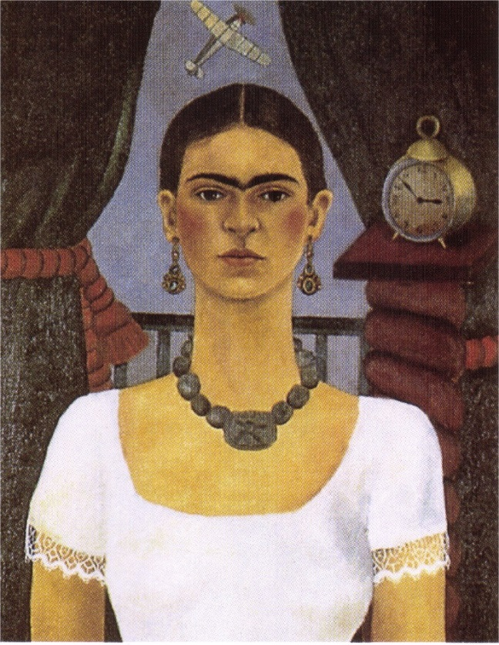
Self-portraits

Slide 4
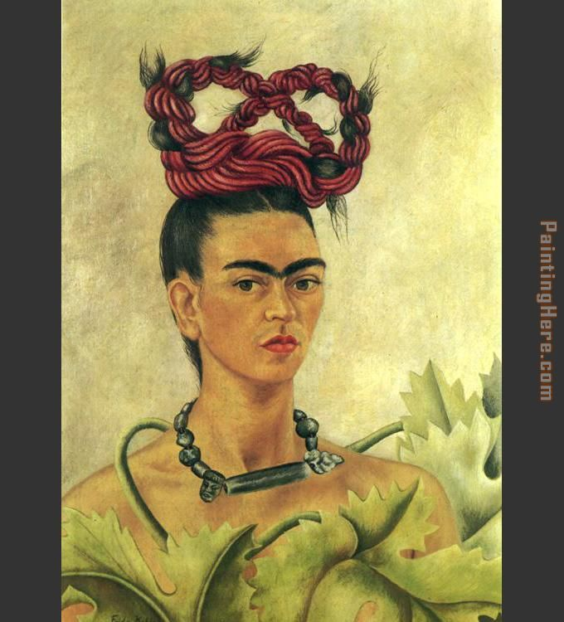
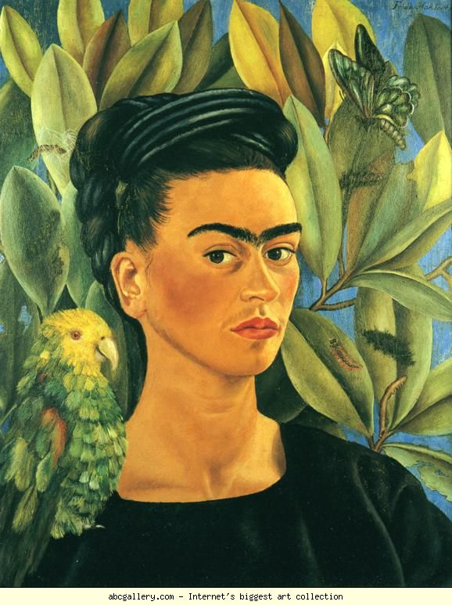
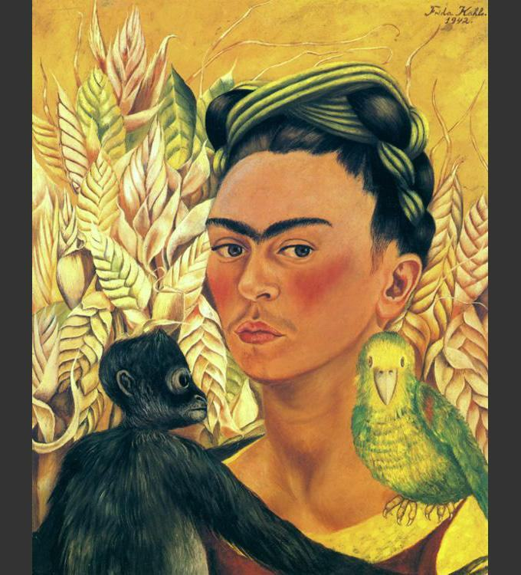

Slide 5
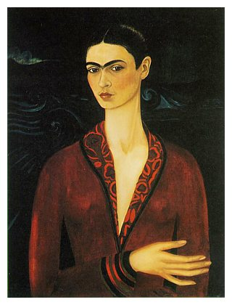
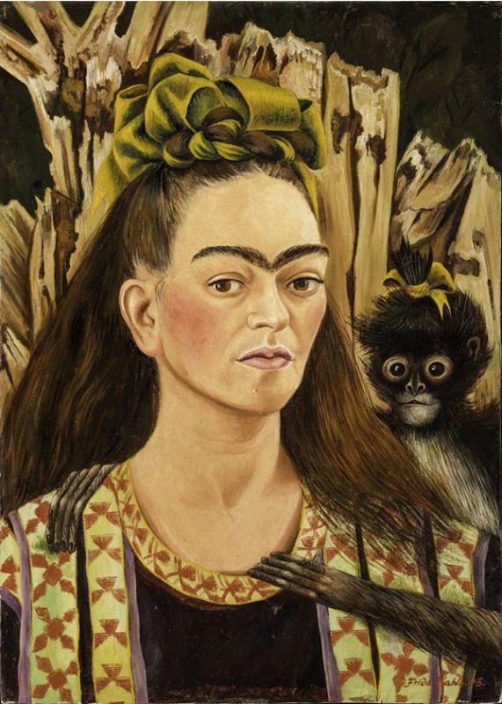
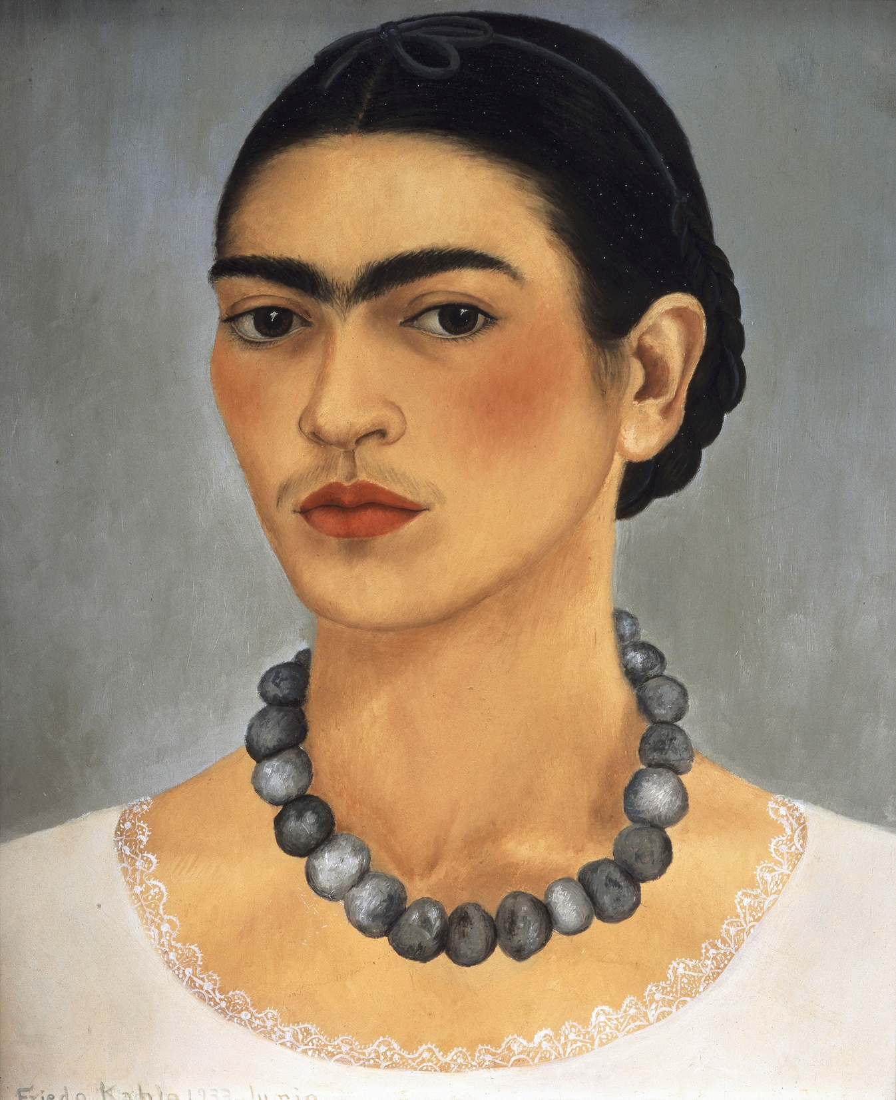

Slide 6
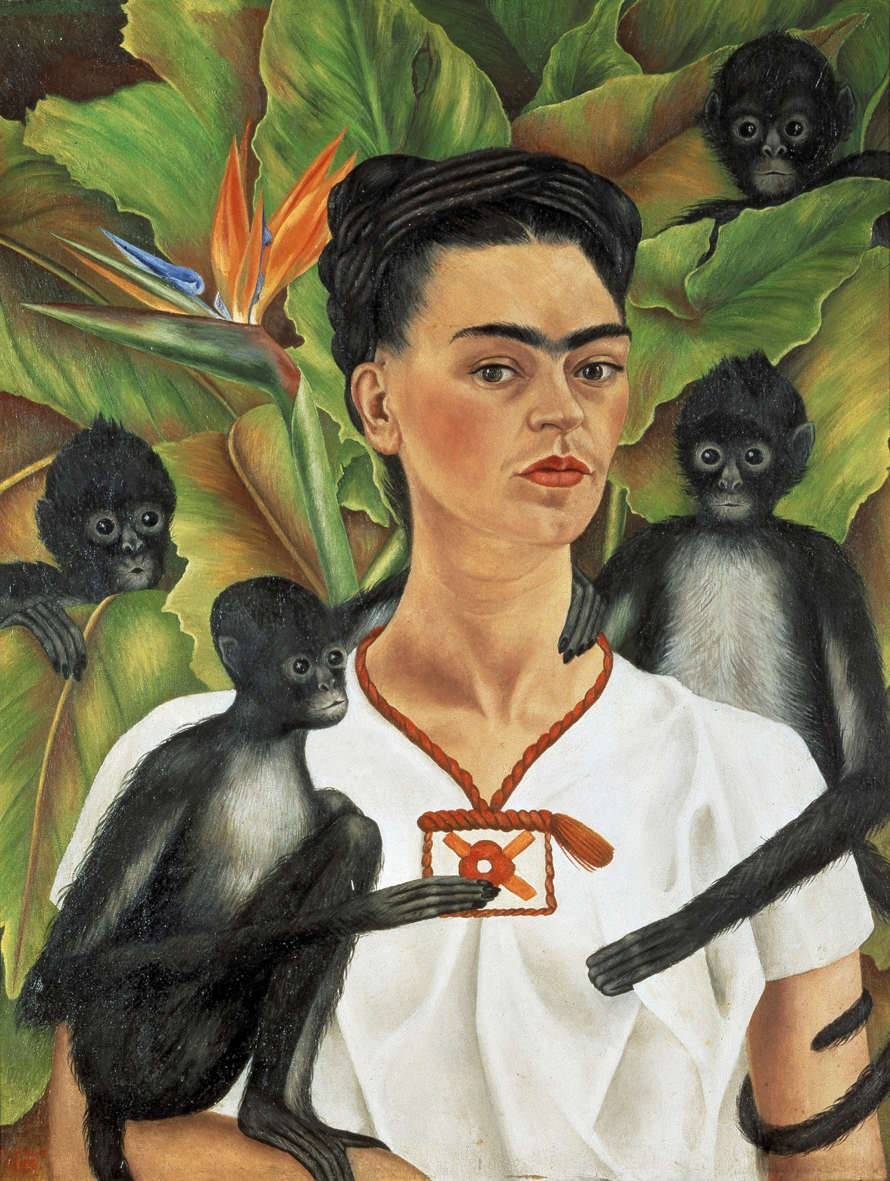
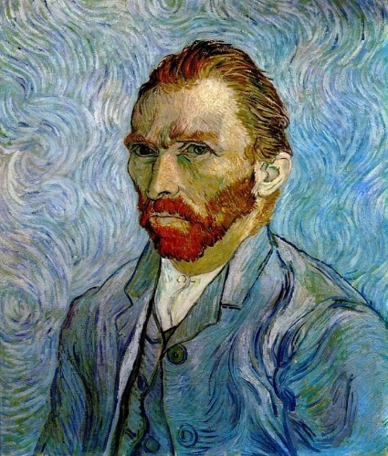
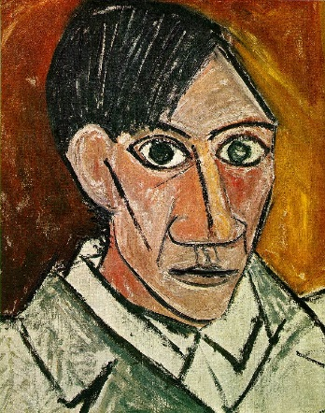
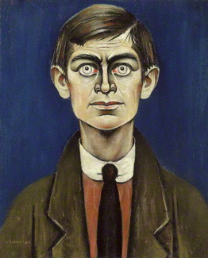
How do Kahlo’s self-portraits differ to those you’ve seen by other artists?
Van Gogh
Picasso
Lowry
Warhol

Slide 7
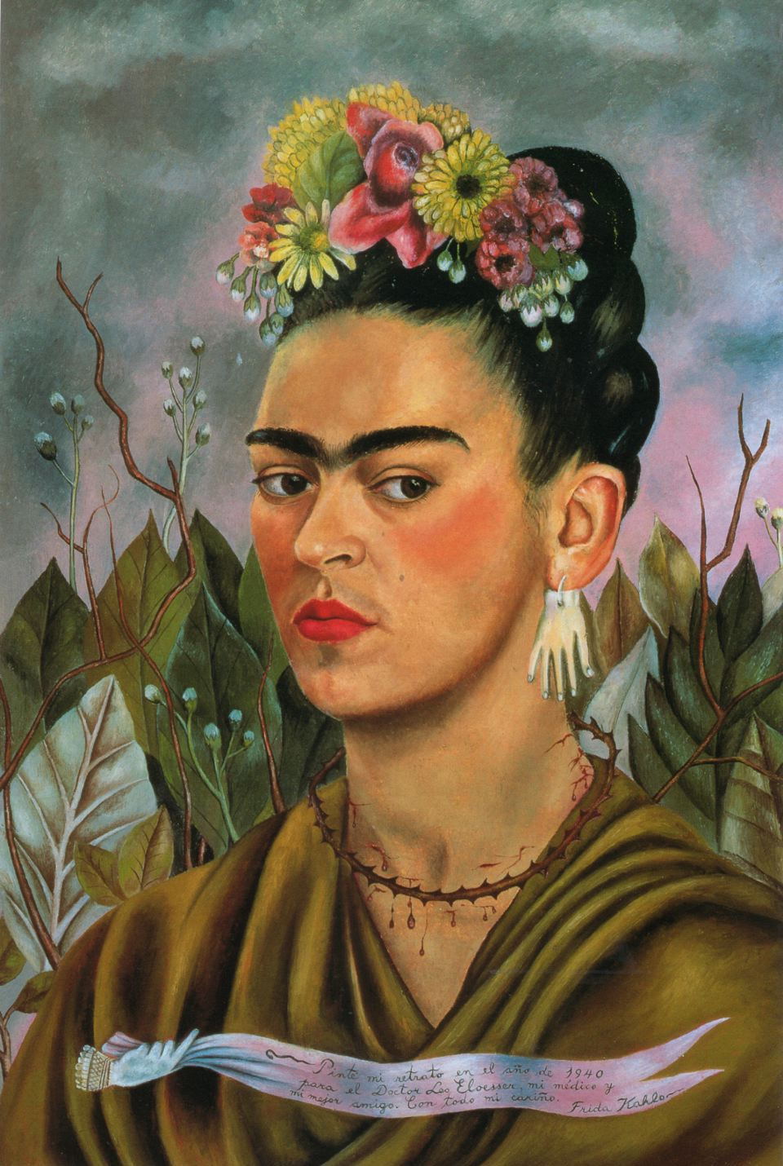
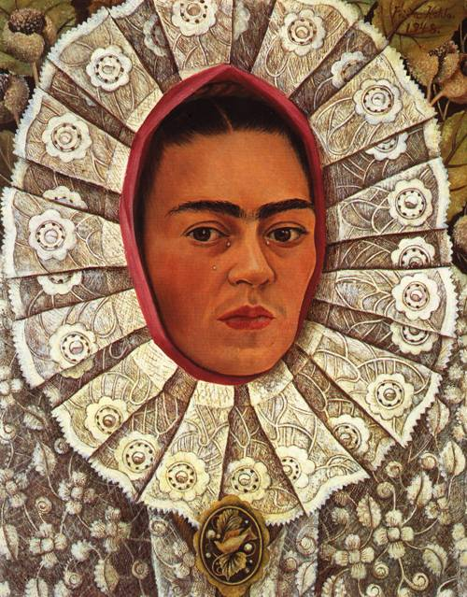
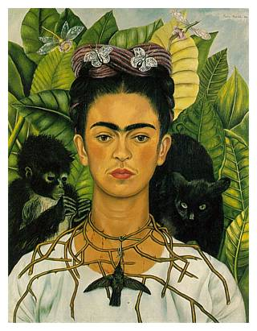
Kahlo’s self-portraits were often in the Surrealist style.
What might she have been communicating?

Slide 8
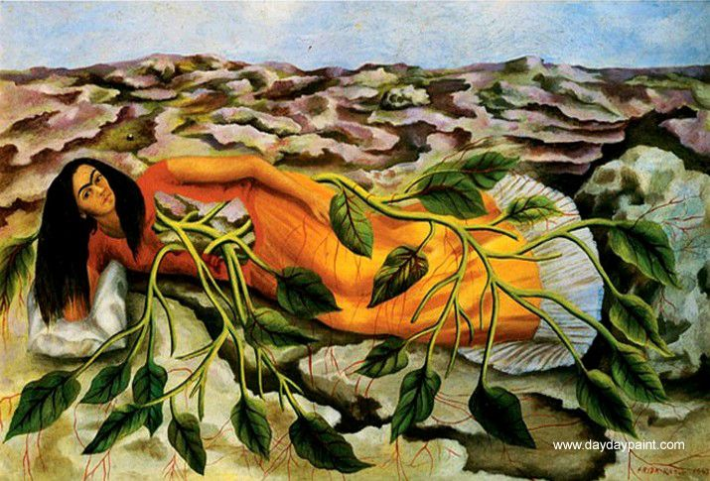
What are your thoughts about this painting, called ‘Roots’?

Slide 9
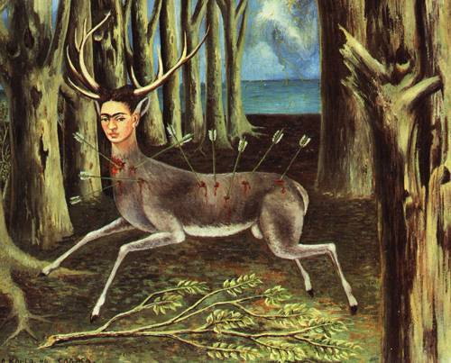
The Surrealism is more obvious in this painting called
‘The Wounded Deer’.
Why do you think she painted herself in this way?
Discuss.
What thoughts and emotions does it evoke in you?

Slide 10
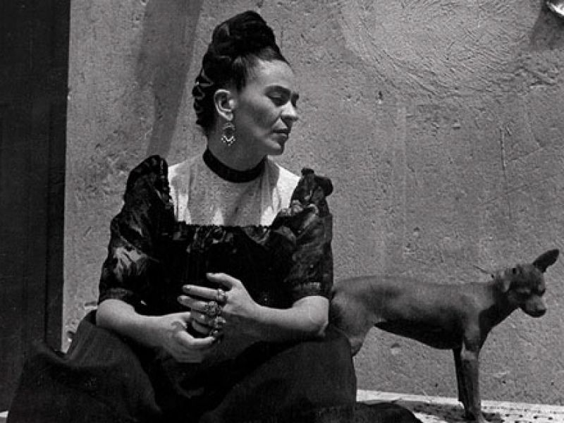
How has Frida Kahlo’s art changed what you knew about, and how you now view, self portraits?

Slide 13
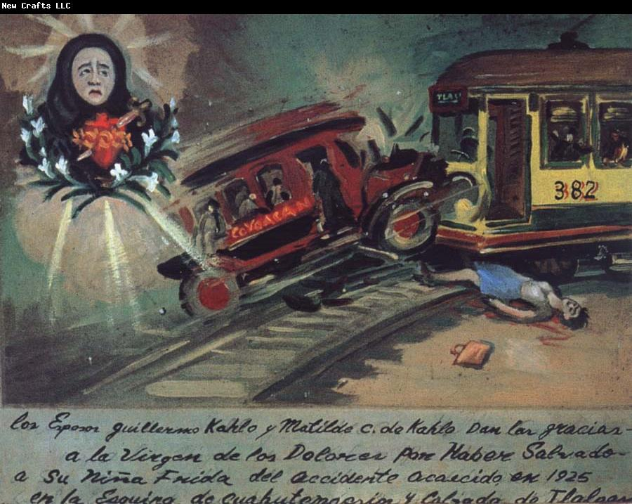
In 1925 when Frida was aged 18, she was the victim of a bus crash, suffering many injuries:
three breaks to her spinal column, a broken collarbone and two broken ribs, eleven fractures in her right leg and a crushed and dislocated right foot. Kahlo’s pelvis broke in three places and a steel handrail deeply pierced her abdomen.
She never fully recovered from her injuries, and sometimes wore a brace or used a wheelchair.

Slide 14
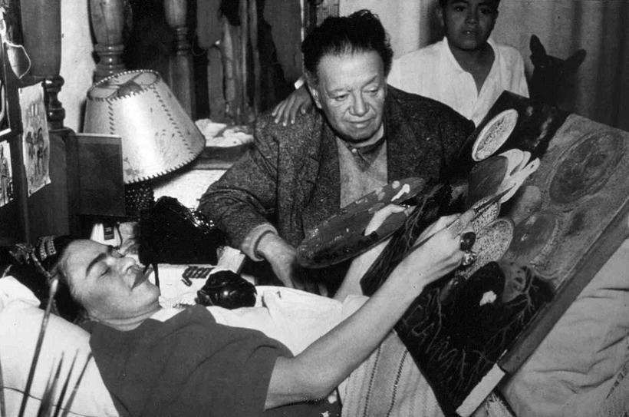
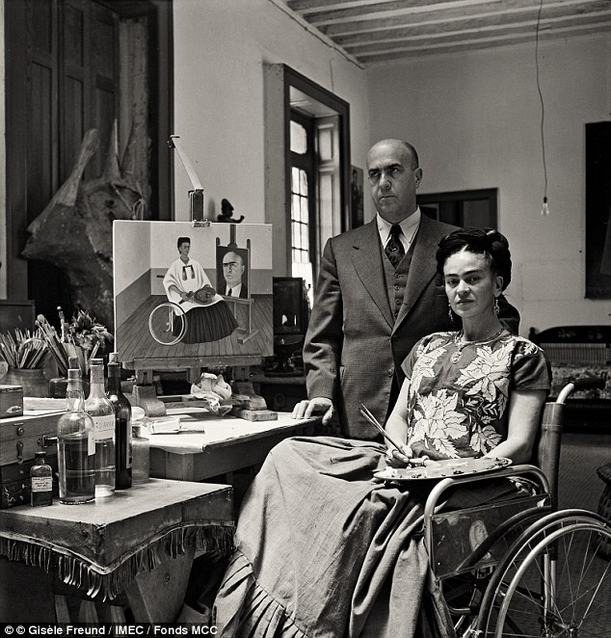
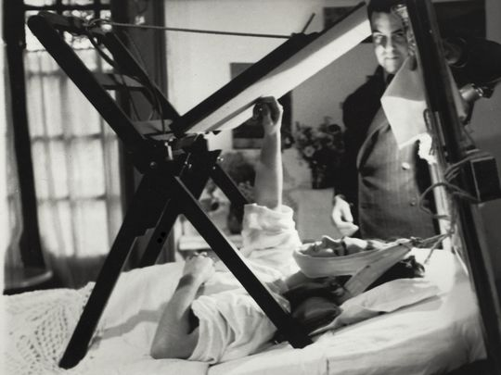

Slide 15
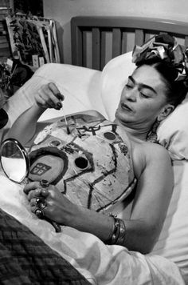
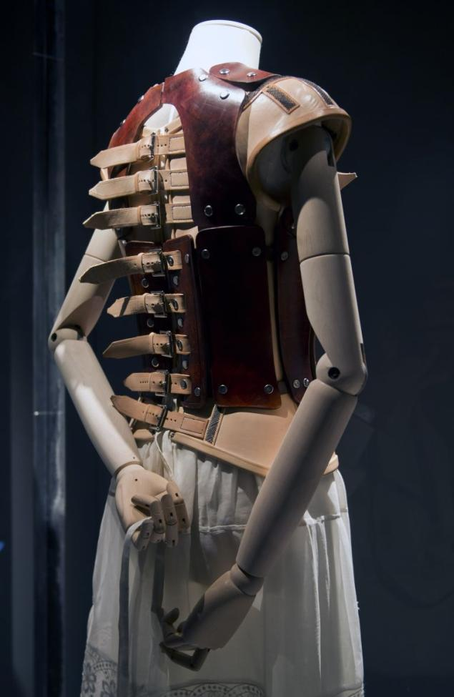
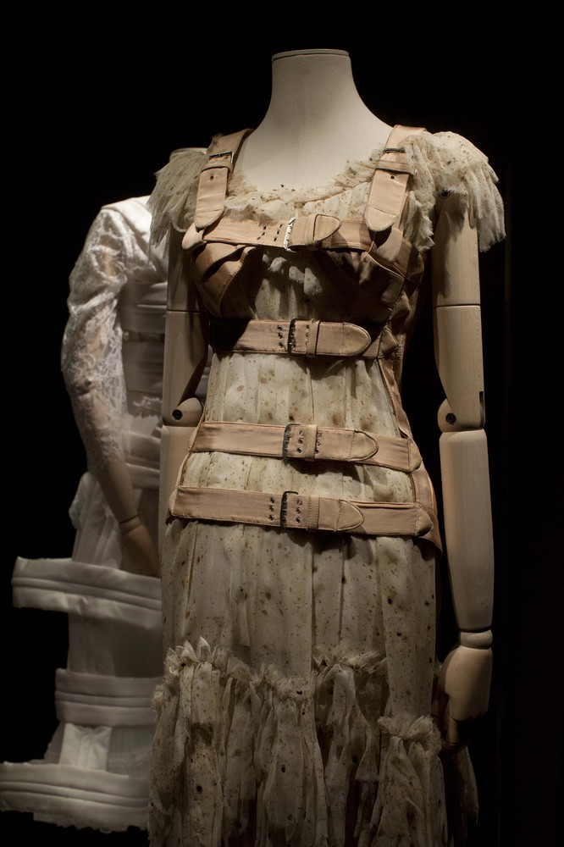

Slide 16
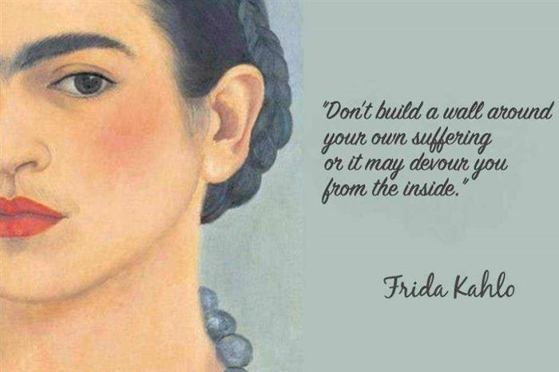

Slide 17
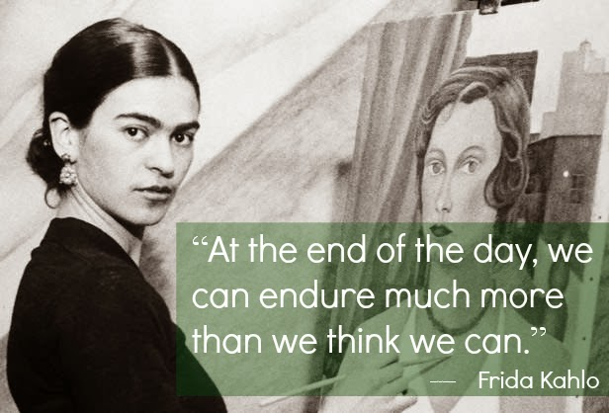

Slide 18
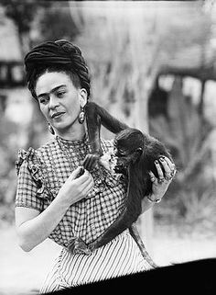
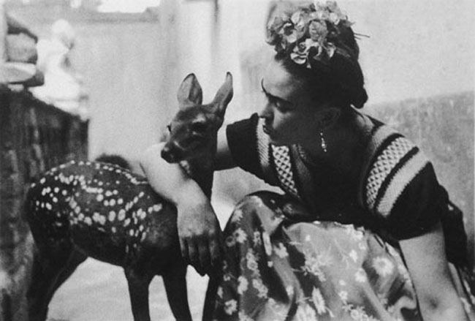
‘Feet, what do I need you for
when I have wings to fly’
– Frida Kahlo

Slide 19
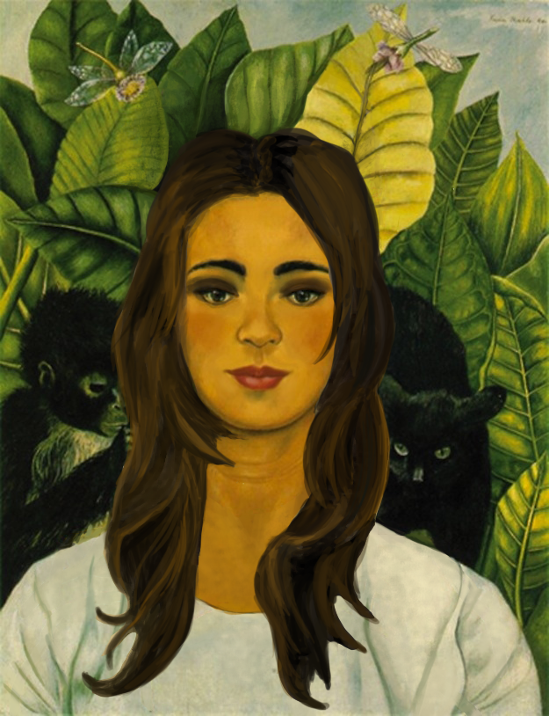
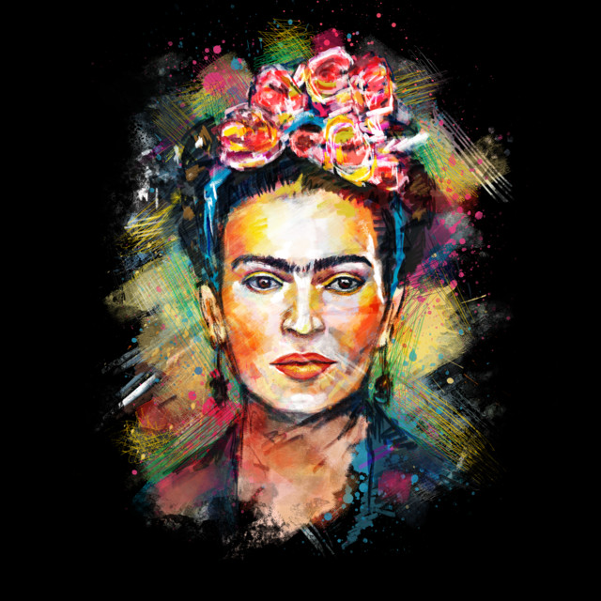
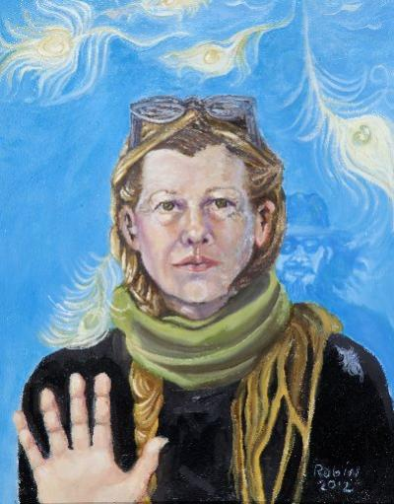
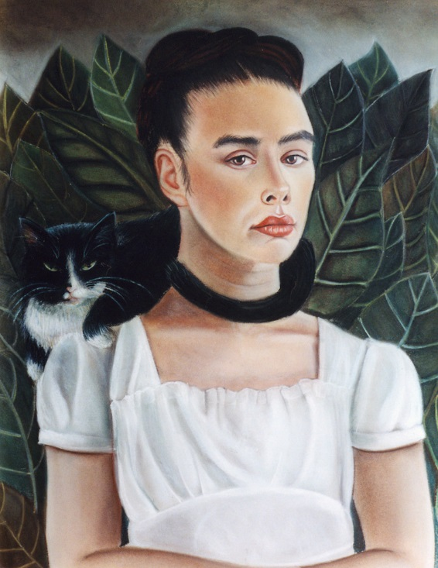
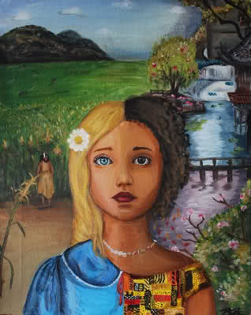
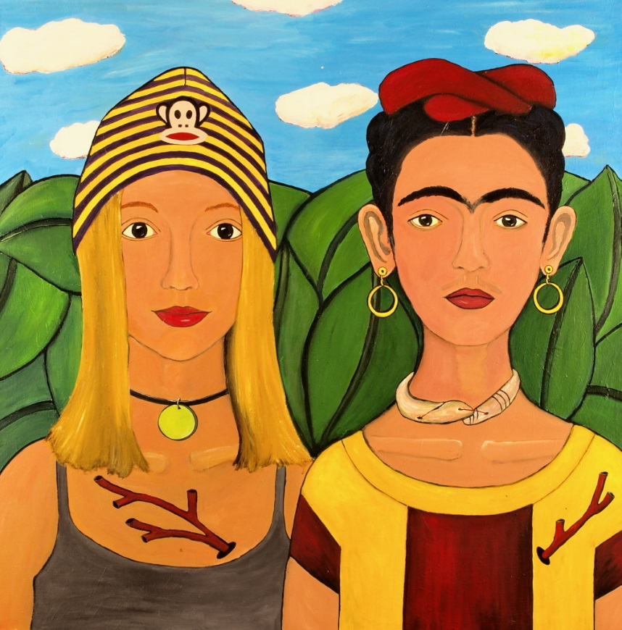
Other artists’ work:
inspired by
Frida Kahlo…

Slide 20
Reflection time:
If you were to create your own self-portrait, what would you include,
in order to tell the audience about you, your likes, personality etc.?
Could you create two self-portraits: positive and negative?
Or create portraits based on positive/negative traits/ life events and emotions
of a character you know from a book or film?
How might Harry Potter paint himself, in the style of Frida Kahlo?
How might Maleficent paint herself?

