Slide 1
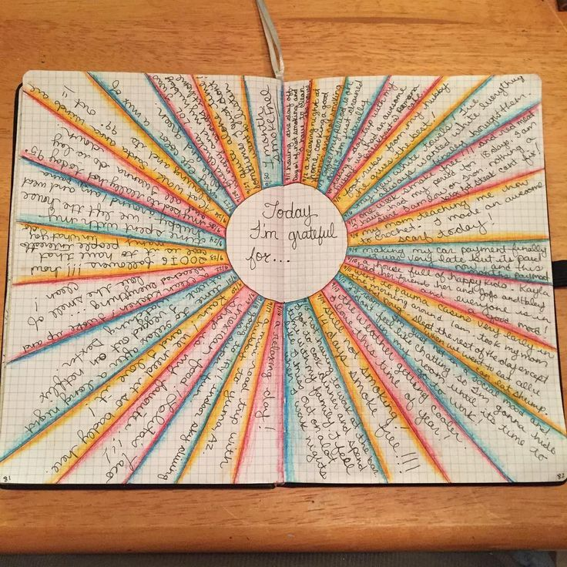
Gratitude: the quality of being thankful; readiness to show appreciation for and to return kindness.
It has been scientifically proven that daily acts of gratitude increase happiness as it trains our brains to look for the positives.
Try to think of things that you are grateful for over the week.
First, you might begin to think about material things that you are grateful for and then move on to non-material things such as sunshine or the smell of a roast dinner!
Create a list and then make a poster to illustrate this.

