Slide 1
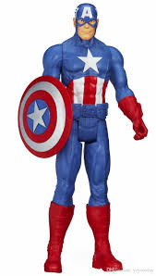
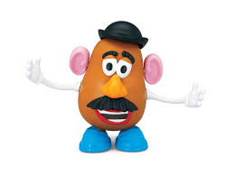
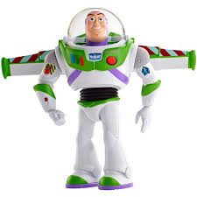
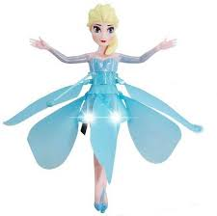
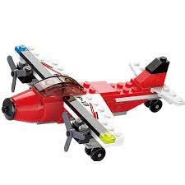
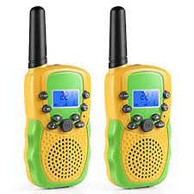
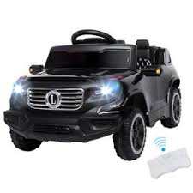
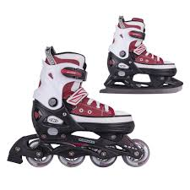
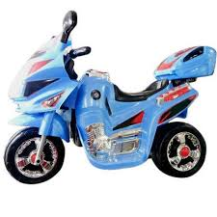
Items up to 10p.
6p
8p
4p
7p
9p
5p
3p
10p
2p
1p

Slide 2
Items up to 20p.
18p
16p
14p
9p
17p
11p
13p
7p
5p
20p

Slide 3
Items up to 25p.
21p
13p
10p
14p
19p
9p
15p
23p
27p
12p

