Slide 1
LIFE/work balance
We have started a #LIFEworkbalance campaign and we need your help to complete our LIFE/work balance survey.
We hope to publish the results soon, so please give 15 minutes of your time to help us get a true picture of school life.
Want to be a part of this campaign? Take the survey on our website and share it with your colleagues!
© Classroom Secrets Limited 2019

Slide 2
Year 1– Summer Block 2 – Fractions – Quarter of a Quantity
About This Resource:
This PowerPoint has been designed to support your teaching of this small step. It includes a starter activity and an example of each question from the Varied Fluency and Reasoning and Problem Solving resources also provided in this pack. You can choose to work through all examples provided or a selection of them depending on the needs of your class.
National Curriculum Objectives:
Mathematics Year 1: (1F1b) Recognise, find and name a quarter as one of four equal parts of an object, shape or quantity
Mathematics Year 1: (1M1) Compare, describe and solve practical problems for mass/weight [for example, heavy/light, heavier than, lighter than, half, quarter]
More Year 1 Fractions resources.
Did you like this resource? Don’t forget to review it on our website.
© Classroom Secrets Limited 2018

Slide 3
Year 1 – Summer Block 2 – Fractions
Step 4: Quarter of a Quantity
© Classroom Secrets Limited 2018

Slide 4
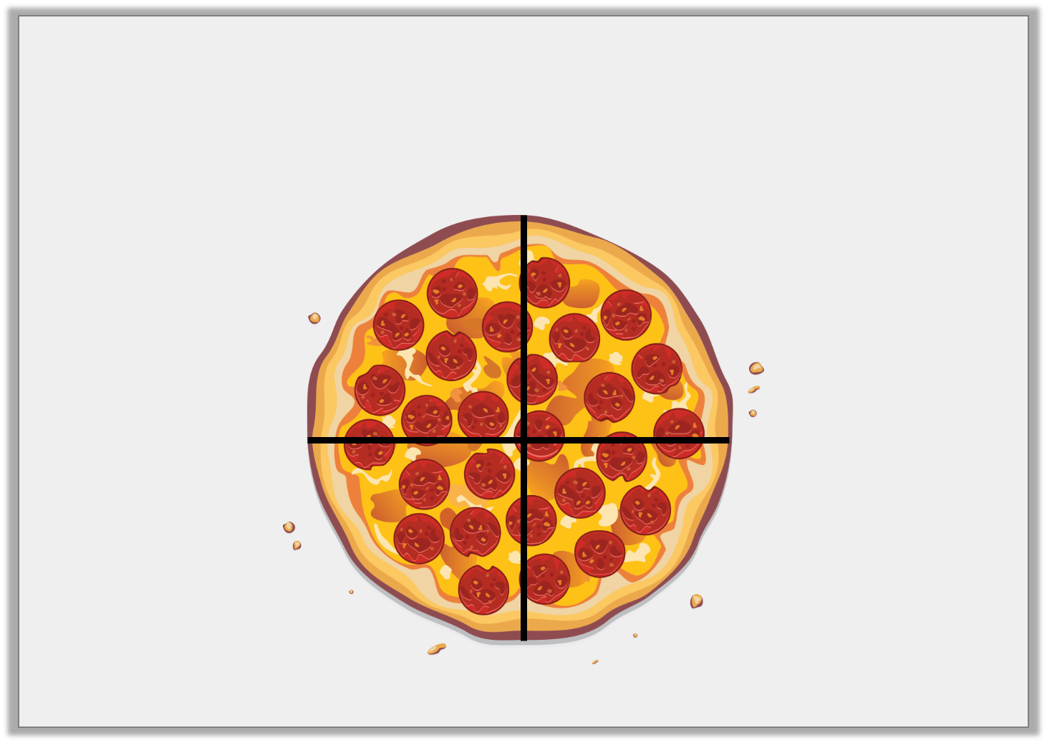
Introduction
How is the pizza split equally?
© Classroom Secrets Limited 2018

Slide 5
Introduction
How is the pizza split equally?
The pizza is cut into 4 equal slices.
© Classroom Secrets Limited 2018

Slide 6
Varied Fluency 1
Complete the statement based on the picture below.
There are _________ boxes. One quarter of _________ is _________ .
© Classroom Secrets Limited 2018

Slide 7
Varied Fluency 1
Complete the statement based on the picture below.
There are _________ boxes. One quarter of _________ is _________ .
20
20
5
© Classroom Secrets Limited 2018

Slide 8
Varied Fluency 2
Use the counters to complete the statement.
One quarter of 16 is ________ .
© Classroom Secrets Limited 2018

Slide 9
Varied Fluency 2
Use the counters to complete the statement.
One quarter of 16 is ________ .
4
© Classroom Secrets Limited 2018

Slide 10
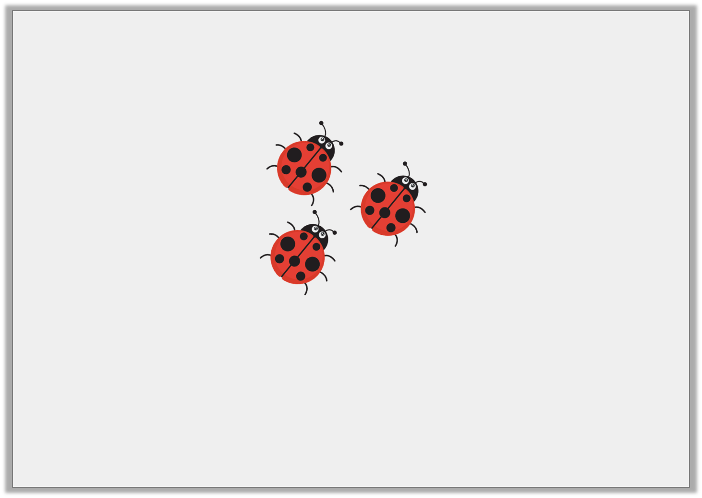
Varied Fluency 3
Here is one quarter.
What is the total?
© Classroom Secrets Limited 2018

Slide 11
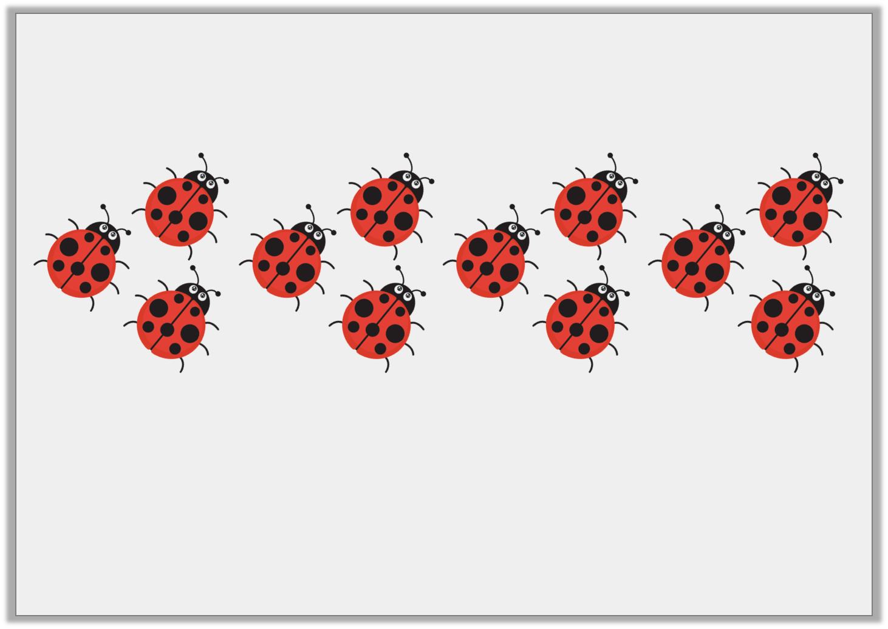
Varied Fluency 3
Here is one quarter.
What is the total?
12
© Classroom Secrets Limited 2018

Slide 12
Varied Fluency 4
Colour one quarter of the triangles.
© Classroom Secrets Limited 2018

Slide 13
Varied Fluency 4
Colour one quarter of the triangles.
© Classroom Secrets Limited 2018

Slide 14
Reasoning 1
Lydia thinks she has coloured in one quarter of the cubes. Is she correct?
How do you know?
© Classroom Secrets Limited 2018

Slide 15
Reasoning 1
Lydia thinks she has coloured in one quarter of the cubes. Is she correct?
How do you know?
Lydia is incorrect because…
© Classroom Secrets Limited 2018

Slide 16
Reasoning 1
Lydia thinks she has coloured in one quarter of the cubes. Is she correct?
How do you know?
Lydia is inocrrect because there are 12 equal parts and one quarter of 12 is 3.
She needs to colour 3 parts, not 4.
© Classroom Secrets Limited 2018

Slide 17
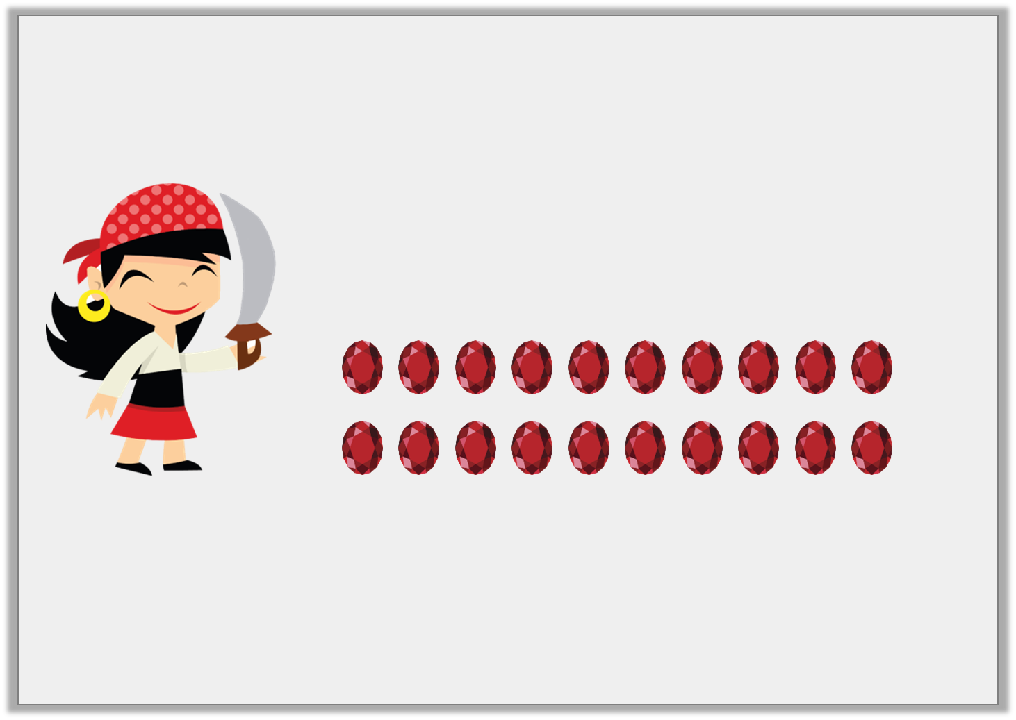
Reasoning 1
Pirate Paula needs to put one quarter of her gems in her treasure chest.
What mistake has Pirate Paula made?
I have put 4 of my gems in my treasure chest.
© Classroom Secrets Limited 2018

Slide 18
Reasoning 1
Pirate Paula needs to put one quarter of her gems in her treasure chest.
What mistake has Pirate Paula made?
Pirate Paula has not shared her gems…
I have put 4 of my gems in my treasure chest.
© Classroom Secrets Limited 2018

Slide 19
Reasoning 1
Pirate Paula needs to put one quarter of her gems in her treasure chest.
What mistake has Pirate Paula made?
Pirate Paula has not shared her gems into 4 equal groups. She should have put away 5 gems.
I have put 4 of my gems in my treasure chest.
© Classroom Secrets Limited 2018

Slide 20
Problem Solving 1
Find three different ways to shade a quarter of the shapes.
© Classroom Secrets Limited 2018

Slide 21
Problem Solving 1
Find three different ways to shade a quarter of the shapes.
Any 5 parts need to be shaded, e.g.
© Classroom Secrets Limited 2018

