Slide 1
LIFE/work balance
We have started a #LIFEworkbalance campaign and we need your help to complete our LIFE/work balance survey.
We hope to publish the results soon, so please give 15 minutes of your time to help us get a true picture of school life.
Want to be a part of this campaign? Take the survey on our website and share it with your colleagues!
© Classroom Secrets Limited 2018
© Classroom Secrets Limited 2018

Slide 2
Year 1 – Summer Block 4 – Place Value – Partitioning Numbers
About This Resource:
This PowerPoint has been designed to support your teaching of this small step. It includes a starter activity and an example of each question from the Varied Fluency and Reasoning and Problem Solving resources also provided in this pack. You can choose to work through all examples provided or a selection of them depending on the needs of your class.
National Curriculum Objectives:
Mathematics Year 1: (1N4) Identify and represent numbers using objects and pictorial representations including the number line, and use the language of: equal to, more than, less than (fewer), most and least
More Year 1 Place Value resources.
Did you like this resource? Don’t forget to review it on our website.
© Classroom Secrets Limited 2018
© Classroom Secrets Limited 2018

Slide 3
Year 1 – Summer Block 4 – Place Value
Step 2: Partitioning Numbers
© Classroom Secrets Limited 2018

Slide 4
Introduction
How many tens does each number have?
How many ones does each number have?
24
31
48
70
86
© Classroom Secrets Limited 2018

Slide 5
Introduction
How many tens does each number have?
How many ones does each number have?
24
31
48
2 tens and 4 ones
3 tens and 1 one
4 tens and 8 ones
70
86
7 tens and 0 ones
8 tens and 6 ones
© Classroom Secrets Limited 2018

Slide 6
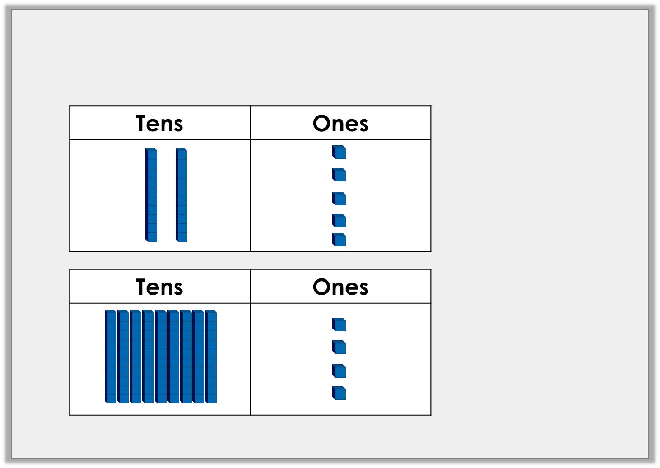
Varied Fluency 1
True or false?
 | True or false?
= 25
 | True or false?
= 84
© Classroom Secrets Limited 2018

Slide 7
Varied Fluency 1
True or false?
 | True or false?
= 25
True
 | True or false?
= 84
False
9 tens and 4 ones = 94
© Classroom Secrets Limited 2018

Slide 8
Varied Fluency 2
Complete these part whole models
 | 3
3
10
1
10
10
1
1
10
1
10
© Classroom Secrets Limited 2018

Slide 9
Varied Fluency 2
Complete these part whole models
5 | 3
3 | 4
10
1
10
10
10
10
1
1
1
1
10
1
10
1
10
© Classroom Secrets Limited 2018

Slide 10
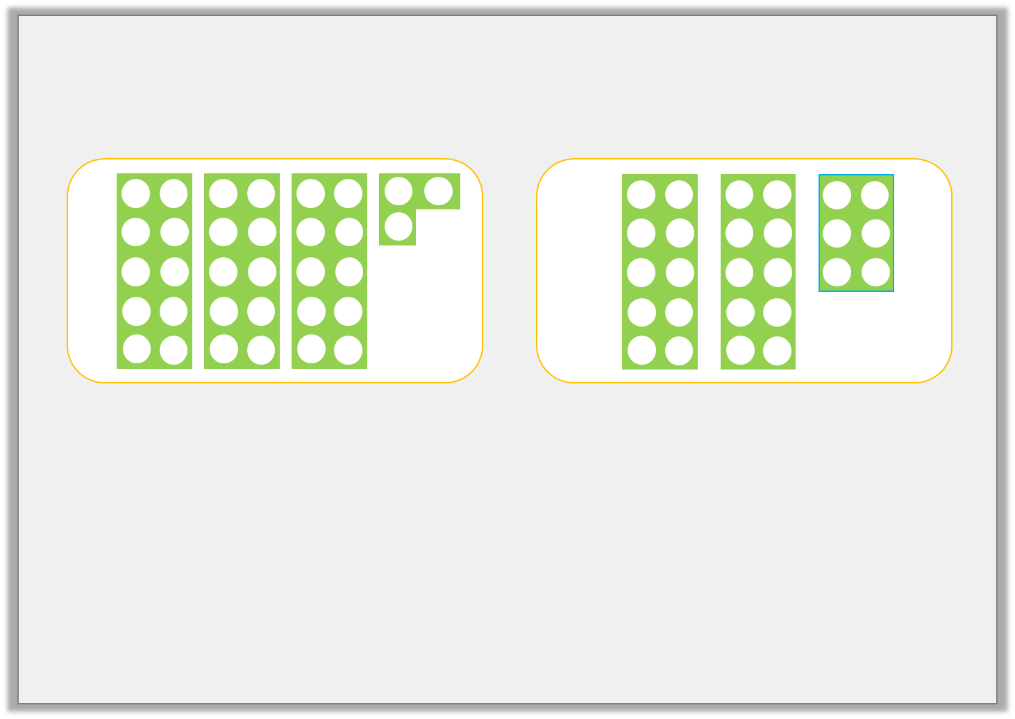
Varied Fluency 3
Match each diagram to a number.
26 | 47 | 33 | 23
© Classroom Secrets Limited 2018

Slide 11
Varied Fluency 3
Match each diagram to a number.
26 | 47 | 33 | 23
© Classroom Secrets Limited 2018

Slide 12
Varied Fluency 4
Complete the sentences below.
36 | has |  | tens | and |  | ones.
 | has | 4 | tens | and | 8 | ones.
59 | has |  | tens | and |  | ones.
 | has | 8 | tens | and | 7 | ones.
© Classroom Secrets Limited 2018

Slide 13
Varied Fluency 4
Complete the sentences below.
36 | has | 3 | tens | and | 6 | ones.
48 | has | 4 | tens | and | 8 | ones.
59 | has | 5 | tens | and | 9 | ones.
87 | has | 8 | tens | and | 7 | ones.
© Classroom Secrets Limited 2018

Slide 14
Problem Solving 1
Lottie has 7 place value counters.
Some are ones and some are tens.
10
1
What total amounts could she have?
Find all the possibilities.
© Classroom Secrets Limited 2018

Slide 15
Problem Solving 1
Lottie has 7 place value counters.
Some are ones and some are tens.
10
1
What total amounts could she have?
10
10
10
10
1
1
1
Find all the possibilities.
Various possible answers, for example: 43 shown above.
Other possibilities are: 7, 16, 25, 34, 52, 61 or 70
© Classroom Secrets Limited 2018

Slide 16
Reasoning 1
Callum has completed the diagram below. Do you think he has done it correctly? Explain how you know.
Greater than 80
Less than 63
65
62
93
64
81
46
© Classroom Secrets Limited 2018

Slide 17
Reasoning 1
Callum has completed the diagram below. Do you think he has done it correctly? Explain how you know.
Callum has not completed the diagram correctly because…
Greater than 80
Less than 63
65
62
93
64
81
46
© Classroom Secrets Limited 2018

Slide 18
Reasoning 1
Callum has completed the diagram below. Do you think he has done it correctly? Explain how you know.
Callum has not completed the diagram correctly because 65 is not greater than 80 and 64 is not less than 63.
Greater than 80
Less than 63
65
62
93
64
81
46
© Classroom Secrets Limited 2018

Slide 19
Problem Solving 2
Use place value counters to make a number which has more than 3 tens and less than 4 ones.
Can you find 5 different answers?
Tens | Ones
10
1
© Classroom Secrets Limited 2018

Slide 20
Problem Solving 2
Use place value counters to make a number which has more than 3 tens and less than 4 ones.
Can you find 5 different answers?
Various possible answers, for example:
43 as shown above, 42, 41, 40, 53, 52, 51, 50
Tens | Ones
10
1
10
10
1
1
1
10
10
© Classroom Secrets Limited 2018

