Slide 1
LIFE/work balance
We have started a #LIFEworkbalance campaign and we need your help to complete our LIFE/work balance survey.
We hope to publish the results soon, so please give 15 minutes of your time to help us get a true picture of school life.
Want to be a part of this campaign? Take the survey on our website and share it with your colleagues!
R
R
PS
PS
© Classroom Secrets Limited 2019

Slide 2
Year 1 – Summer Block 4 – Place Value – Ordering Numbers
About This Resource:
This PowerPoint has been designed to support your teaching of this small step. It includes a starter activity and an example of each question from the Varied Fluency and Reasoning and Problem Solving resources also provided in this pack. You can choose to work through all examples provided or a selection of them depending on the needs of your class.
National Curriculum Objectives:
Mathematics Year 1: (1N1a) Count to and across 100, forward and backwards, beginning with 0 or 1, or from any given number
Mathematics Year 1: (1N2a) Count, read and write numbers to 100 in numerals
Mathematics Year 1: (1N2b) Given a number, identify one more and one less
Mathematics Year 1: (1N4) Identify and represent numbers using objects and pictorial representations including the number line, and use the language of: equal to, more than, less than (fewer), most and least
More Year 1 Place Value resources.
Did you like this resource? Don’t forget to review it on our website.
© Classroom Secrets Limited 2019

Slide 3
Year 1 – Summer Block 4 – Place Value
Step 5: Ordering Numbers
© Classroom Secrets Limited 2019

Slide 4
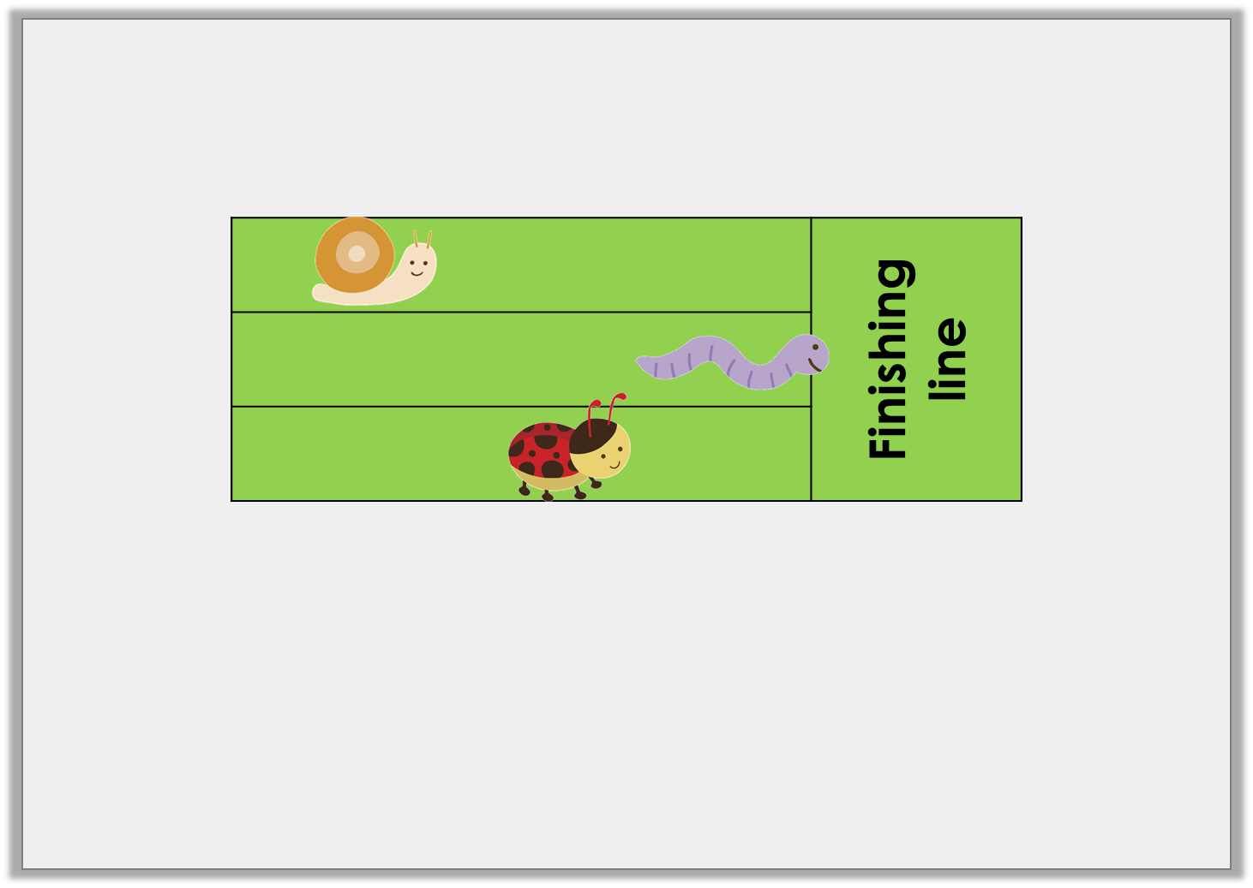
Introduction
Put the insects in the correct order on the podium.
1st
2nd
3rd
© Classroom Secrets Limited 2019

Slide 5
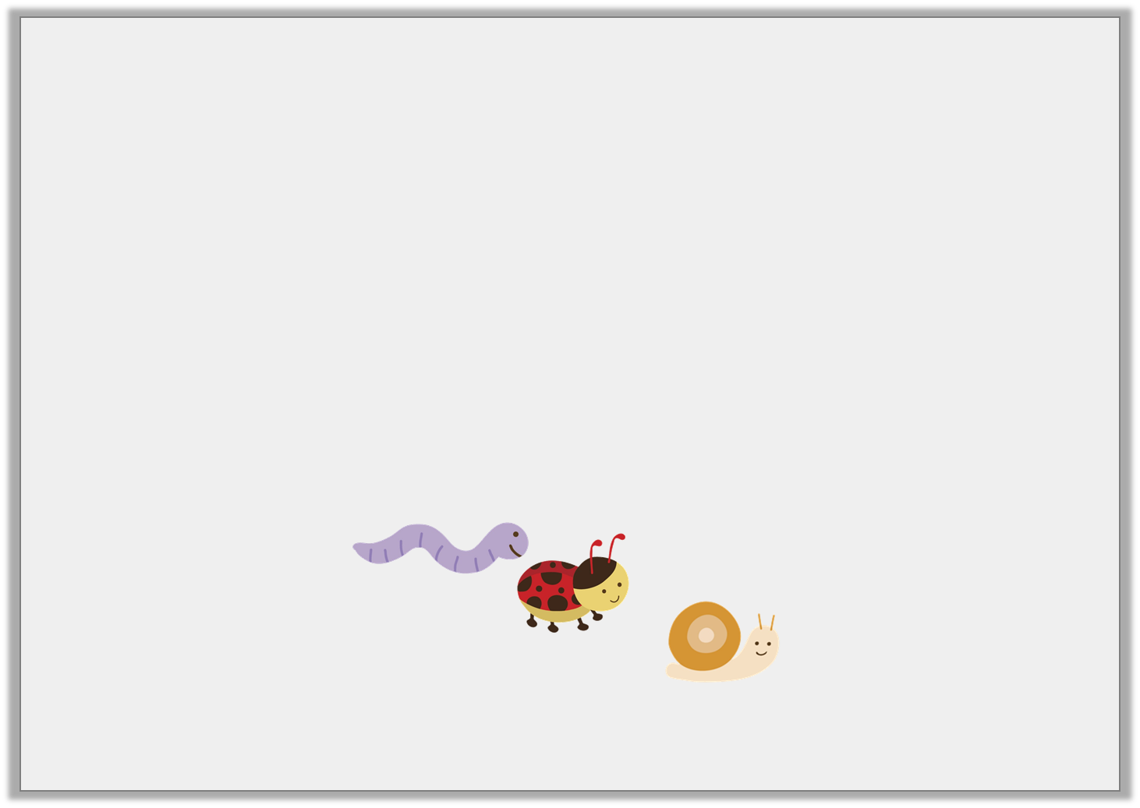
Introduction
Put the insects in the correct order on the podium.
 | Finishing line
1st
2nd
3rd
© Classroom Secrets Limited 2019

Slide 6
Varied Fluency 1
Order these numbers from smallest to largest.
2
19
52
79
25
97
© Classroom Secrets Limited 2019

Slide 7
Varied Fluency 1
Order these numbers from smallest to largest.
2
smallest
19
25
52
79
97
largest
© Classroom Secrets Limited 2019

Slide 8
Varied Fluency 2
Draw lines to join the cards to their place on the line.
Least
Most
15
51
© Classroom Secrets Limited 2019

Slide 9
Varied Fluency 2
Draw lines to join the cards to their place on the line.
Least
Most
15
51
© Classroom Secrets Limited 2019

Slide 10
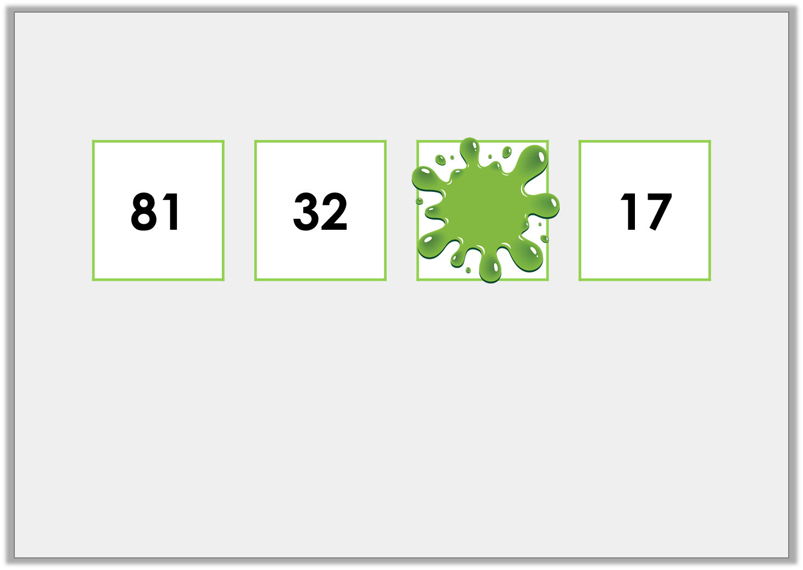
Varied Fluency 3
Fill in a number that could go in the box.
© Classroom Secrets Limited 2019

Slide 11
Varied Fluency 3
Fill in a number that could go in the box.
Various possible answers, for example:
21
© Classroom Secrets Limited 2019

Slide 12
Varied Fluency 4
Match each bug to its position in the race.
second |  | first |  | fifth
Finish
© Classroom Secrets Limited 2019

Slide 13
Varied Fluency 4
Match each bug to its position in the race.
second |  | first |  | fifth
Finish
© Classroom Secrets Limited 2019

Slide 14
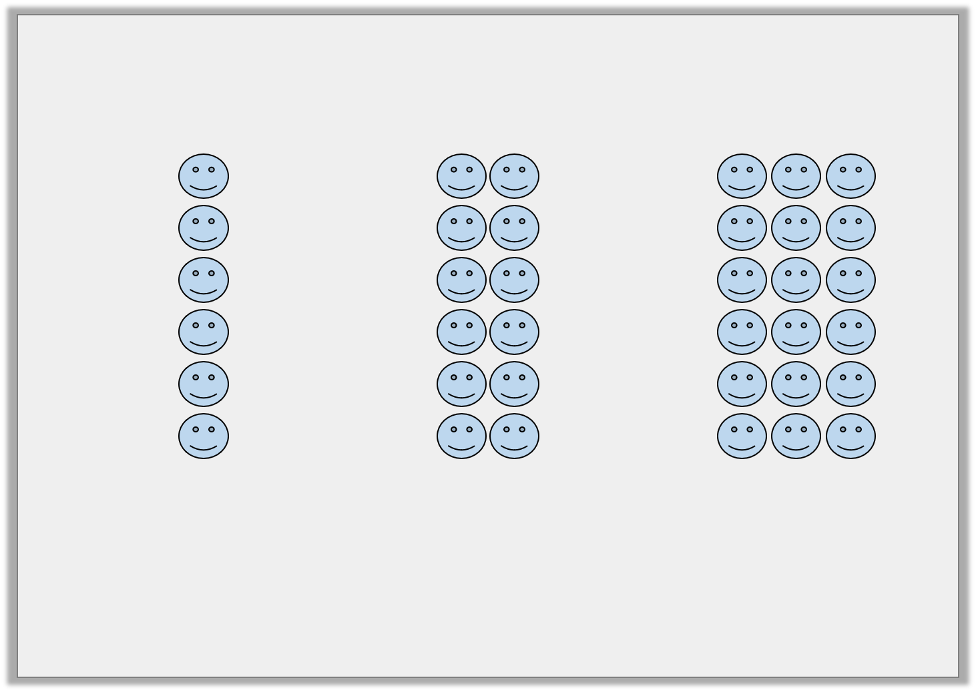
Reasoning 1
How have these objects been ordered?
Explain how you know.
© Classroom Secrets Limited 2019

Slide 15
Reasoning 1
How have these objects been ordered?
Explain how you know.
The objects have been ordered from __________ to __________ . The number of objects in the first group is ___________________ the second and third group.
© Classroom Secrets Limited 2019

Slide 16
Reasoning 1
How have these objects been ordered?
Explain how you know.
The objects have been ordered from __________ to __________ . The number of objects in the first group is ___________________ the second and third group.
least
most
less than
© Classroom Secrets Limited 2019

Slide 17
Problem Solving 1
Find the number that does not fit the order and explain why it is wrong.
16, | 27, | 46, | 56,
68, | 62 , | 89, | 99,
© Classroom Secrets Limited 2019

Slide 18
Problem Solving 1
Find the number that does not fit the order and explain why it is wrong.
62 does not fit the order because the numbers are increasing but 62 is less than 68.
16, | 27, | 46, | 56,
68, | 62 , | 89, | 99,
© Classroom Secrets Limited 2019

Slide 19
Reasoning 2
Year 1 are talking about sports day.
Max says,
Is he correct? Explain how you know.
Five people finished the race ahead of me. I came fifth in the race.
© Classroom Secrets Limited 2019

Slide 20
Reasoning 2
Year 1 are talking about sports day.
Max says,
Is he correct? Explain how you know.
Max is not correct. If there were __________ people ahead of him, he must have been __________ .
Five people finished the race ahead of me. I came fifth in the race.
© Classroom Secrets Limited 2019

Slide 21
Reasoning 2
Year 1 are talking about sports day.
Max says:
Is he correct? Explain how you know.
Max is not correct. If there were __________ people ahead of him, he must have been __________ .
Five people finished the race ahead of me. I came fifth in the race.
five
sixth
© Classroom Secrets Limited 2019

