Slide 1
LIFE/work balance
We have started a #LIFEworkbalance campaign and we need your help to complete our LIFE/work balance survey.
We hope to publish the results soon, so please give 15 minutes of your time to help us get a true picture of school life.
Want to be a part of this campaign? Take the survey on our website and share it with your colleagues!
© Classroom Secrets Limited 2018

Slide 2
Year 1 – Summer Block 6 – Time – Time to the Hour
About This Resource:
This PowerPoint has been designed to support your teaching of this small step. It includes a starter activity and an example of each question from the Varied Fluency and Reasoning and Problem Solving resources also provided in this pack. You can choose to work through all examples provided or a selection of them depending on the needs of your class.
National Curriculum Objectives:
Mathematics Year 1: (1M4a) Tell the time to the hour and half past the hour and draw the hands on a clock face to show these times
More Year 1 Time resources.
Did you like this resource? Don’t forget to review it on our website.
© Classroom Secrets Limited 2018

Slide 3
Year 1 – Summer Block 6 – Time
Step 3: Time to the Hour
© Classroom Secrets Limited 2018

Slide 4
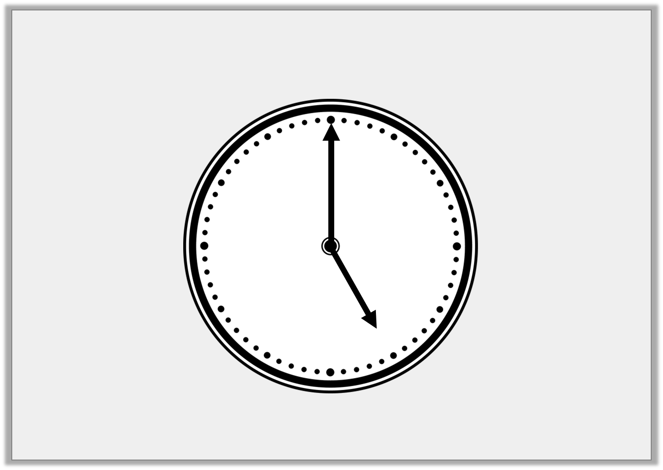
Introduction
The numbers have fallen off the clock face.
Can you put them back in the correct place?
What time is it? How do you know?
5
10
11
6
8
4
1
9
12
2
3
7
© Classroom Secrets Limited 2018

Slide 5
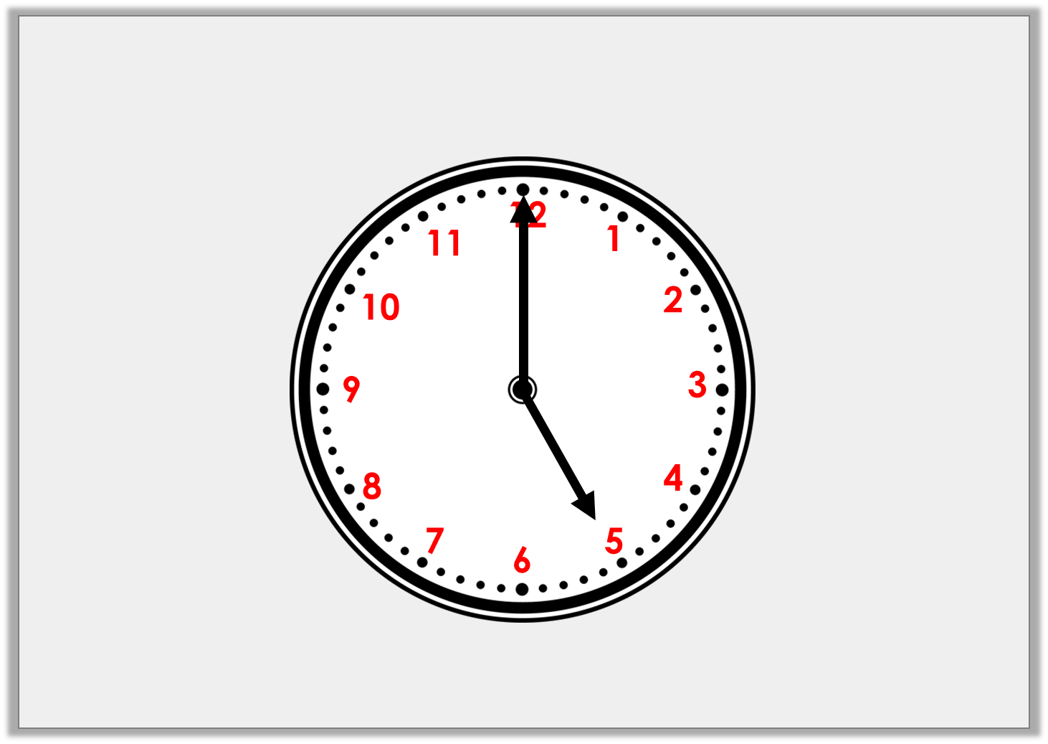
Introduction
The numbers have fallen off the clock face.
Position the numbers correctly.
What time is it? How do you know?
It is 5 o’clock.
The minute hand is pointing to 12 and the hour hand is pointing to 5.
© Classroom Secrets Limited 2018

Slide 6
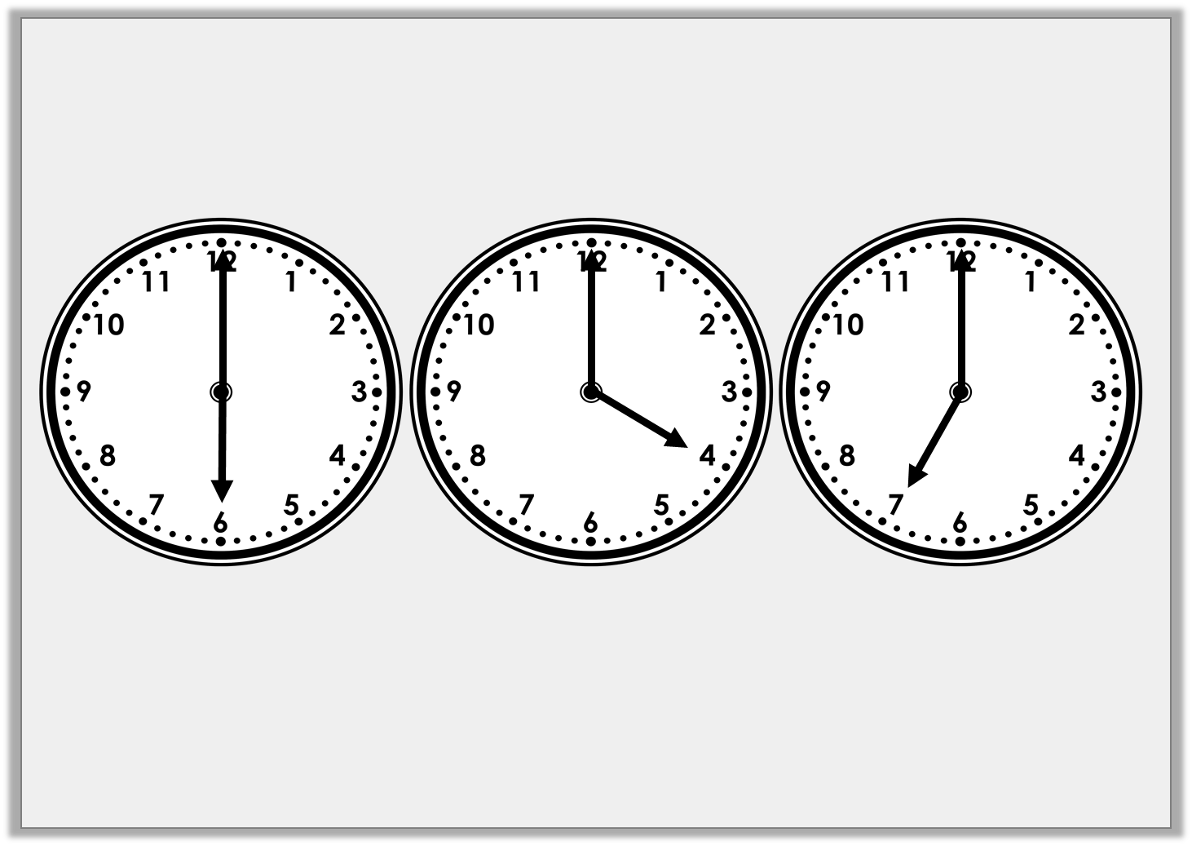
Varied Fluency 1
Which clock shows 7 o’clock?
Clock A
Clock B
Clock C
© Classroom Secrets Limited 2018

Slide 7
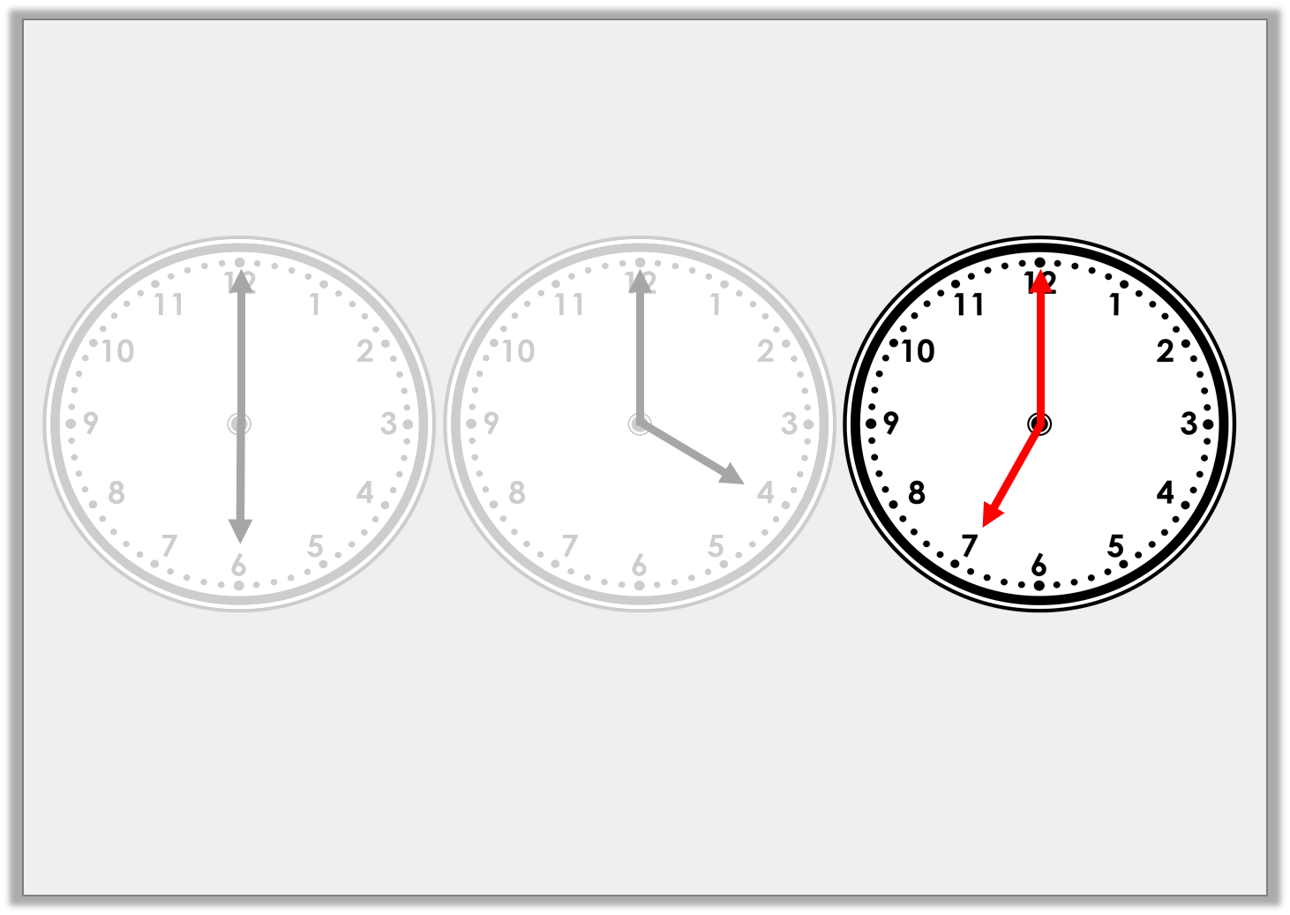
Varied Fluency 1
Which clock shows 7 o’clock?
Clock A
Clock B
Clock C
© Classroom Secrets Limited 2018

Slide 8
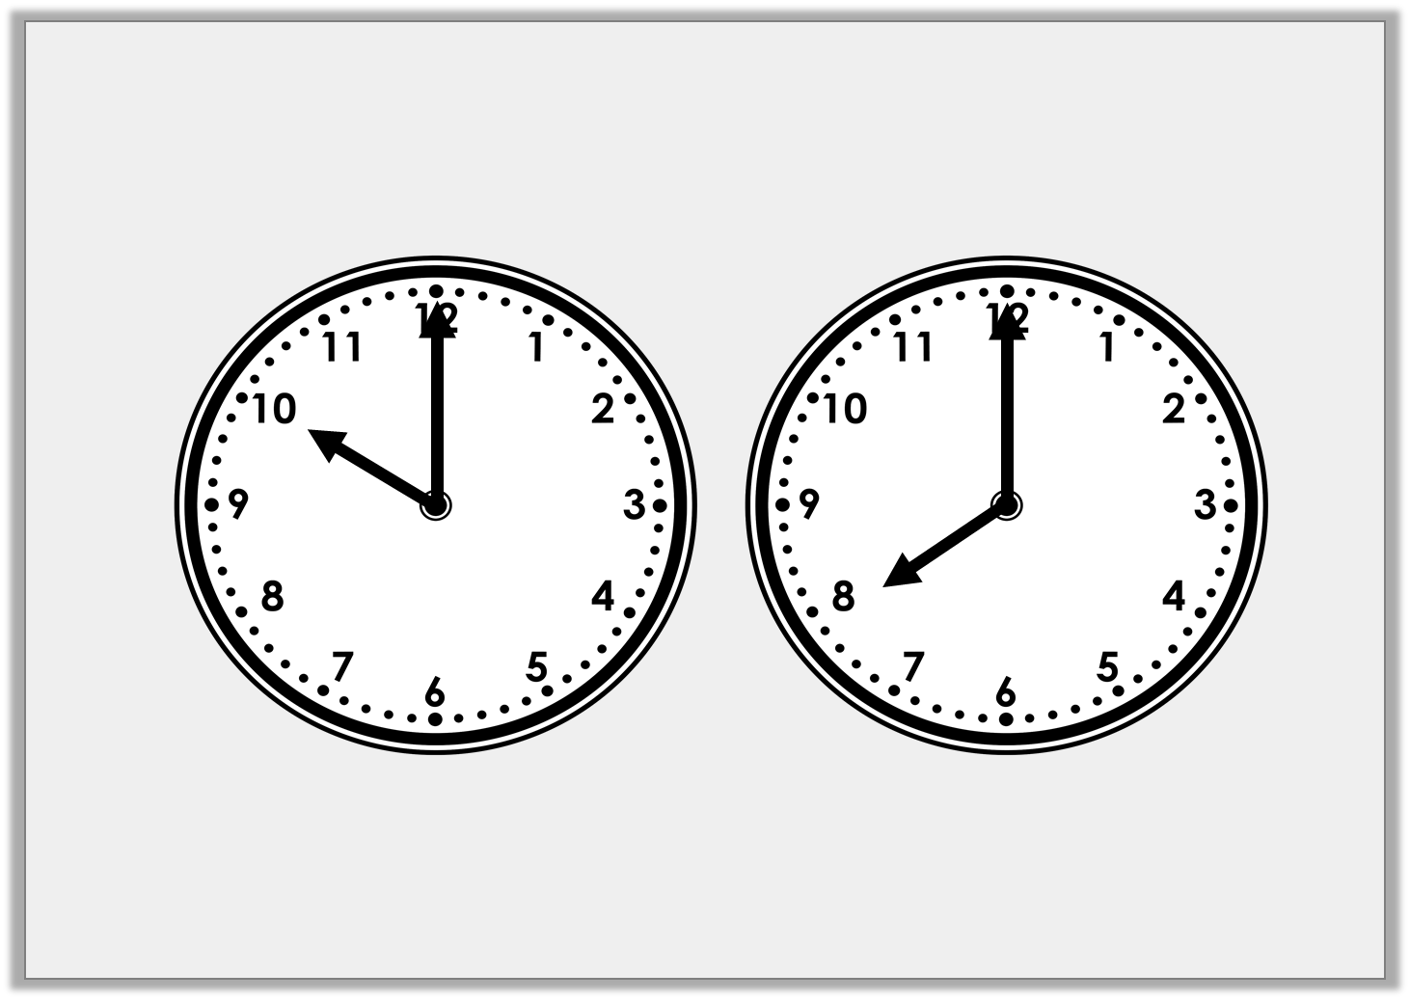
Varied Fluency 2
Write the time shown on each clock in words.
© Classroom Secrets Limited 2018

Slide 9
Varied Fluency 2
Write the time shown on each clock in words.
ten o’clock
eight o’clock
© Classroom Secrets Limited 2018

Slide 10
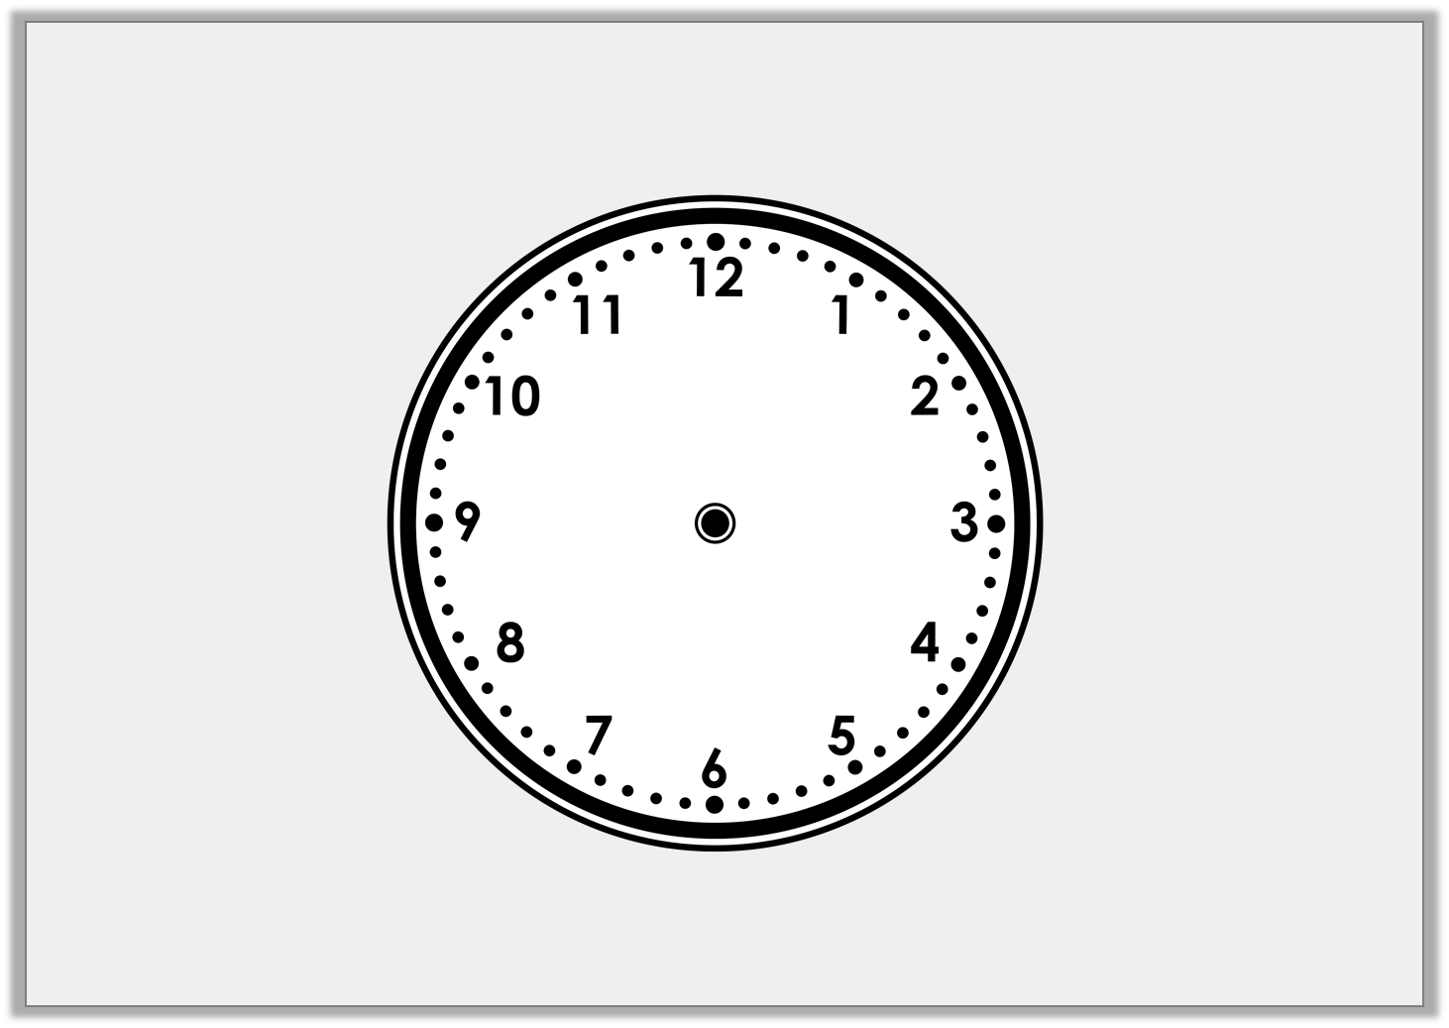
Varied Fluency 3
Draw the hands to show eight o’clock.
© Classroom Secrets Limited 2018

Slide 11
Varied Fluency 3
Draw the hands to show eight o’clock.
© Classroom Secrets Limited 2018

Slide 12
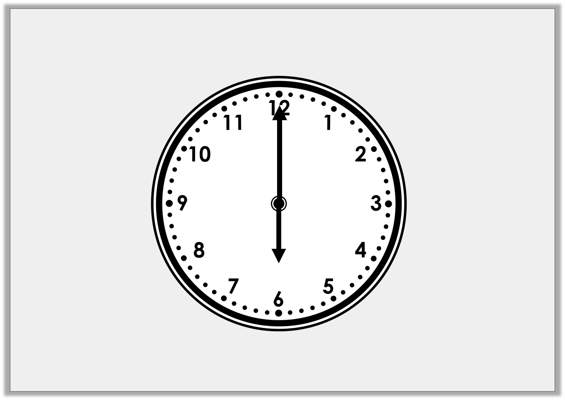
Varied Fluency 4
True or false? The time is six o’clock.
© Classroom Secrets Limited 2018

Slide 13
Varied Fluency 4
True or false? The time is six o’clock.
True
© Classroom Secrets Limited 2018

Slide 14
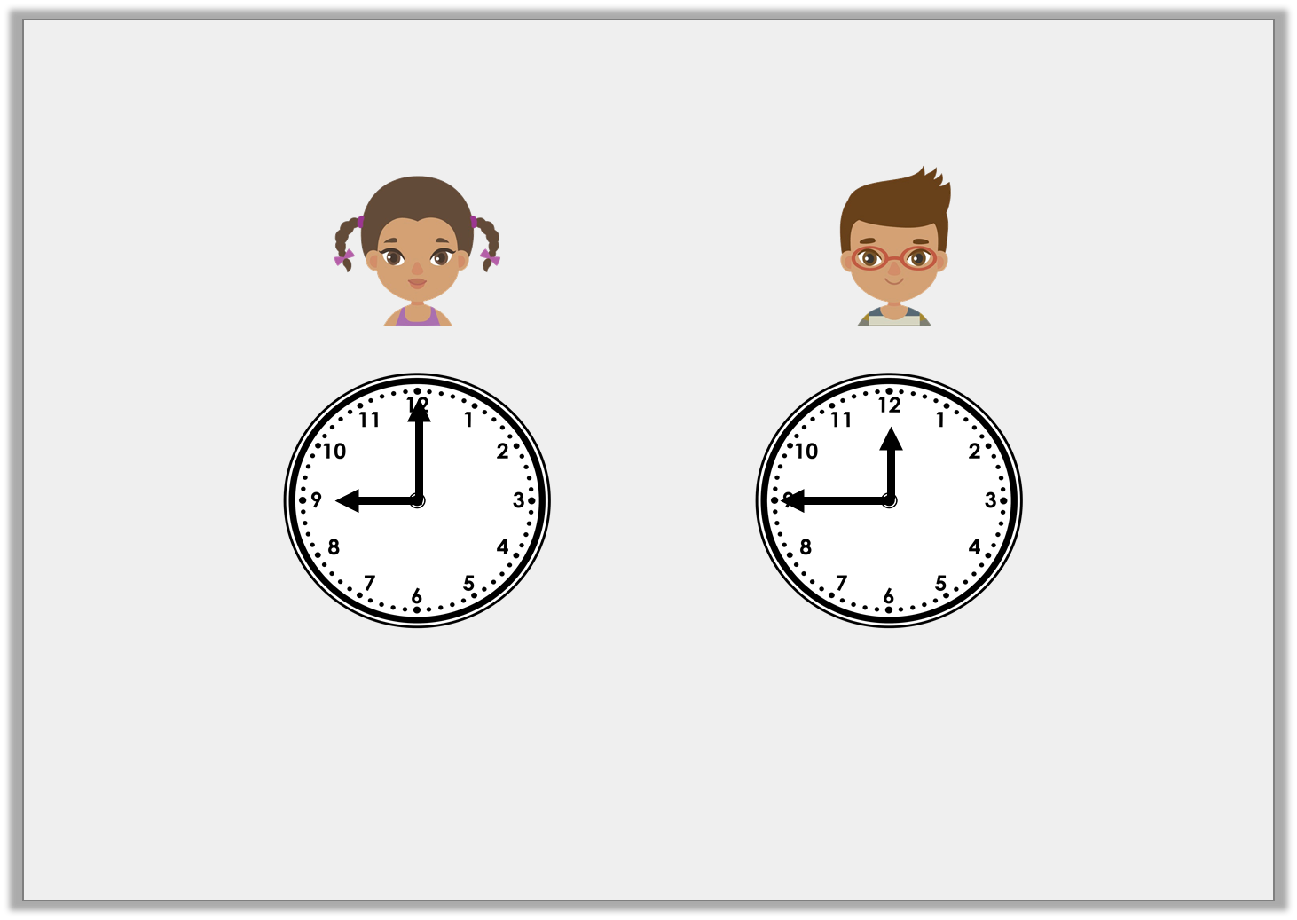
Reasoning 1
Two children show nine o’clock on a clock.
Who is correct? Explain how you know.
Chloe
Ryan
© Classroom Secrets Limited 2018

Slide 15
Reasoning 1
Two children show nine o’clock on a clock.
Who is correct? Explain how you know.
Chloe is correct because…
Chloe
Ryan
© Classroom Secrets Limited 2018

Slide 16
Reasoning 1
Two children show nine o’clock on a clock.
Who is correct? Explain how you know.
Chloe is correct because the hour hand is pointing to 9 and the minute hand is pointing to 12. Ryan is incorrect because the hands are the wrong way round.
Chloe
Ryan
© Classroom Secrets Limited 2018

Slide 17
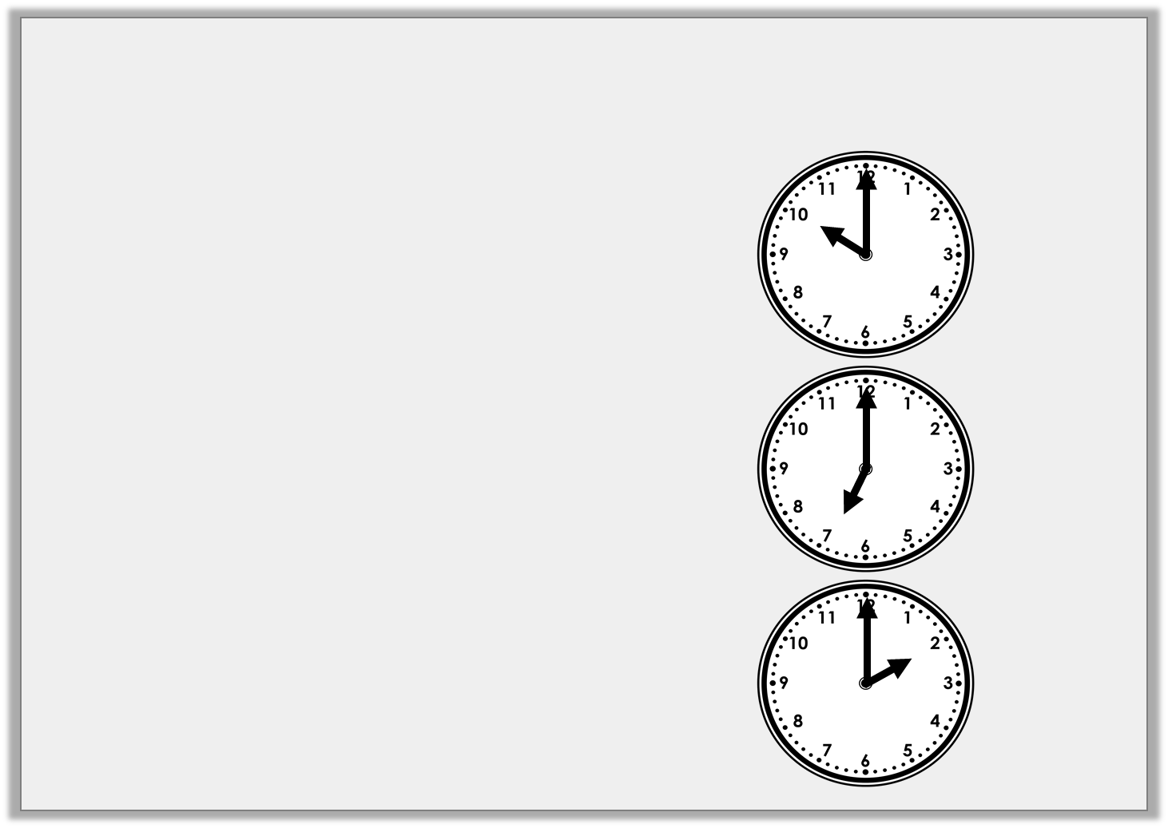
Problem Solving 1
Match two pairs to find the odd one out.
two o’clock
ten o’clock
© Classroom Secrets Limited 2018

Slide 18
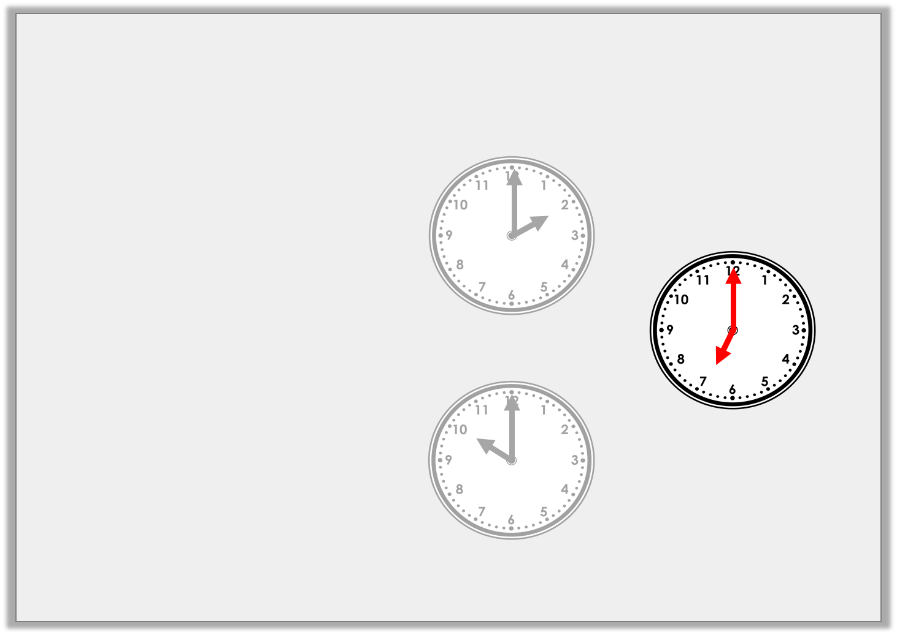
Problem Solving 1
Match two pairs to find the odd one out.
two o’clock
ten o’clock
© Classroom Secrets Limited 2018

Slide 19
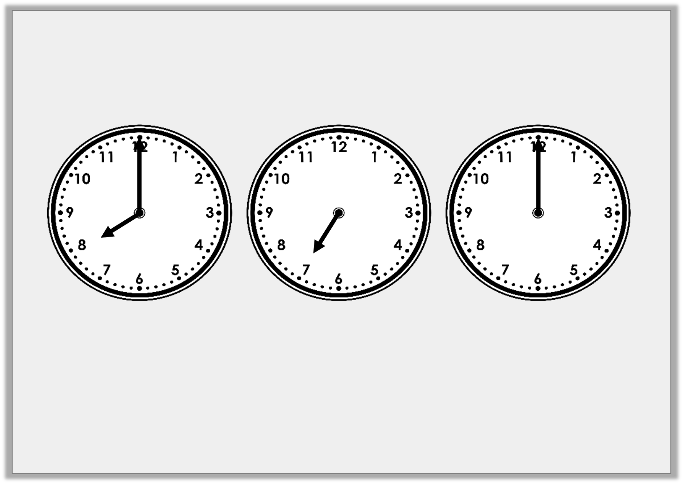
Problem Solving 2
Add the hands to each clock and write the time in words to complete the pattern.
_____ o’clock
seven o’clock
6 _____________
© Classroom Secrets Limited 2018

Slide 20
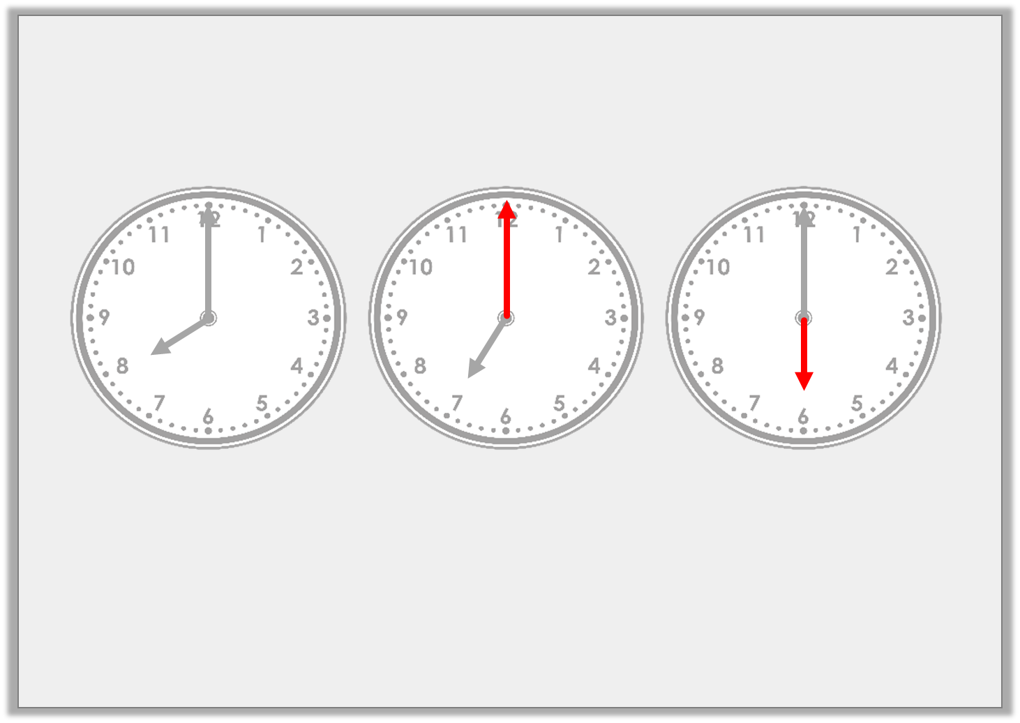
Problem Solving 2
Add the hands to each clock and write the time in words to complete the pattern.
8 o’clock
seven o’clock
6 o’clock
© Classroom Secrets Limited 2018

