Slide 1
Introduction to Year 3 Miss Swinburne & Mrs Bassindale September 2020

Slide 2
Meet the Teacher
The aim of this Powerpoint is to inform you a little more of what your child, and you, can expect in Year 3.

Slide 3
Main differences to KS1…
There is no afternoon break.
The children can bring in their own (small!) bag.
We hope children from Year 3 up will have the opportunity to participate in the summer drama production.
After the first couple of weeks, they leave the building by themselves at home time.

Slide 4
Homework Guidance
The homework set should take around 20-30 minutes to complete
Expect high standards. Encourage them to stretch themselves and not complete the bare minimum
We are happy for you to support your children if they find a particular concept tricky but you should not have to do the work for them
Notes:
Homework is set to support and enhance the work and learning done in school. It helps children to prepare for new lessons as well as consolidate learning. At the same time, the practise of tables, spelling and reading helps to keep things ‘ticking over’.
The tasks set should not take more than 20-30 mins to complete – timing is everything. Perhaps do the spellings, reading and tables during the week and then find time at the weekend for any other tasks.
We expect homework to be completed to the same high standard as work is in school. In a writing task, punctuation must be used correctly and common words shouldn’t be misspelt. Presentation should also be a high priority – work should have a title and be dated.

Slide 5
Homework
Homework book – with a note outlining the homework for the week.
This year set every Wednesday and due to be handed in the following Wednesday.
Times Tables – the children will be given times tables to learn. First tested in order and then out of order, then division.
Spellings – Each week, the spellings will follow a specific pattern or will be a set of key words.
My Maths – linked to the work completed in class (logins etc will be sent home).

Slide 6
Reading
Please aim to hear your child at least 4-5 times a week and record in their reading records.
Reading records are collected weekly. In addition to this, a note is made of how many times a child has read over the week and signed by an adult.
Question their comprehension of the text and encourage them to be aware of what they are reading at both sentence and whole text level.
Guided reading also takes place in class where key questions are asked to build comprehension.

Slide 7
Reading system
Colour coded system
Assessed at different times
Children progress through the levels
Will not be moved before completing the core books and some free reading
Clearly marked in their reading records
They are not to move on until a teacher has approved it
Reading records are checked weekly
Notes:
This is the KS2 system which, if they haven’t already, your children will be progressing onto during this year.
We assess the children’s reading at different times – they read with a teacher or TA during guided reading and other subjects and in class reading (together, reading their work to the class, reading a question out etc)
Given all this independence there are always teething problems at the beginning. We will do our best to remind them to change their books. Please record their reading accurately in the reading records.

Slide 8
Spellings
The children will be given a weekly test (every Thursday) on a set of spellings based either on key words or a specific spelling pattern.
Words that sound similar will be put into a sentence during the test to avoid confusion.

Slide 9
Spelling Scheme
We are currently revising key words and assessing the children’s spelling levels. These need to be secure before moving on to more difficult words. These will be retested throughout the year.
We are beginning to teach spelling through a spelling scheme as part of our daily Literacy lesson.

Slide 10
What can you do to help?
Handwriting practice
Regular reading
Times tables (2,5, 10, 3, 4, 8)
Revise number facts (bonds, doubles, halves etc)
PE Kit – does it fit? Is it named?
Learn to tie shoelaces and neck ties

Slide 11
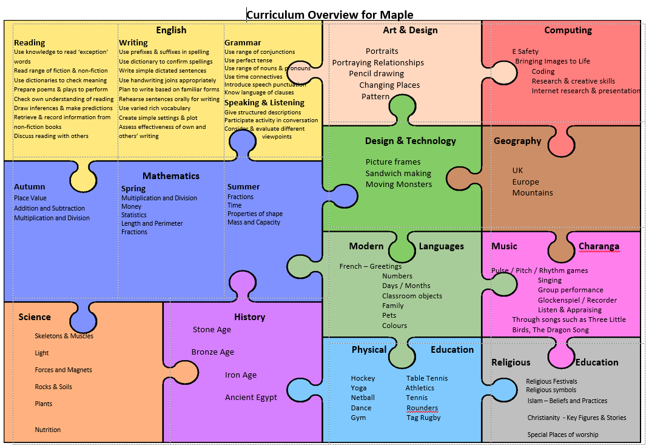

Slide 12
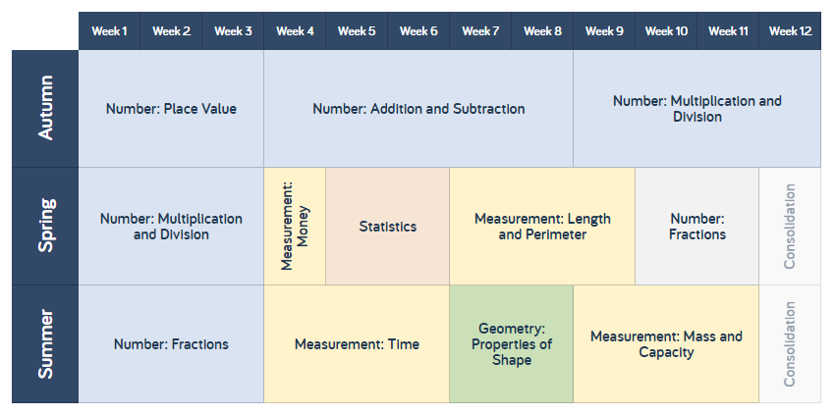
Maths
Notes:
Each term the methods develop in order for the children to move onto short (standard/formal written methods). In Yr 3 your children will learn methods such as column addition and subtraction and later on in the year they will be introduced to the grid method for multiplication.
Multiplication and division calculations will be based on the childrens’ knowledge of times tables – so very important to work on these. Not just by rote but need to have an understanding of division and multiplication and be able to use both operations.
We will support the children by introducing them to certain strategies to help with their calculations for example: number lines/hopping (to the next 10) and of course we use practical resources as much as possible to help put ideas into context.
A solid knowledge of the number system and how it works will really help your child as will knowing, understanding and having a fast recall of number facts: number bonds to 10, 20, 100, doubles and near doubles and times tables.

Slide 13
IT IS ESSENTIAL THAT ALL KEY STAGE 2 PUPILS KNOW THEIR MULTIPLICATION TABLES. This is the foundation of all our mathematics! You can use Times Tables Rockstars to practise. Log ins will be sent home in due course.
Notes:
The children are not expected to know them all straight away but they are expected to learn (and continue to learn) their tables throughout the year. They will be tested weekly – first in order and then out of order. The National expectation is for children in Year 3 to know and be able to use the 2, 5, 10, 3 ,4 & 8 times tables and division facts by the end of year 3. If the are ready they will also be given the 6, 7, 9, 11 & 12 times tables to learn.
This cannot be emphasised enough. Once they get to Year 5 & 6 if they don’t know their tables, they will struggle to go any further (it underpins everything – fractions, long division, short division etc)

Slide 14
www.mymaths.co.uk
It is an interactive resource that can be used in the class as a teaching resource.
It can be used by individuals as a teaching resource.
It can be used at home for homework and revision.
It provides a teacher with instant feedback as to how the pupils have done with their homework.
MyMaths log-ins will go home in homework books as and when required.
Notes:
Will use for homework after Christmas.
It’s a great resource. If for any reason there is a problem with the internet at home, let me know and they can always do it in the ICT suite.
The idea is that they complete the tasks independently however, it’s absolutely fine to support them with this aspect of their homework too. Sometimes, they might need a pencil and paper to hand to jot down some working out.
Make sure that your child saves their work and checks out at the end as otherwise it won’t register that it’s been done/finished.

Slide 15
Trips
The children will have the opportunity to partake in a range of trips and experiences whilst in Year 3.
Last year we visited Celtic Harmony, Botanic Gardens in Cambridge and The Fitzwilliam Museum.

Slide 16
Please do not hesitate to contact us if you have any questions. b.bassindale@wransom.herts.sch.uk a.swinburne@wransom.herts.sch.uk

