Slide 1
Foundation Stage & KS1 Information for Parents
How we teach English

Slide 2
Objectives
Phonics
Reading
Writing
Speaking and Listening

Slide 3
Reading Expectations – Reception
Phonics
Blending
Segmenting
Phoneme
Grapheme
Diagraph
Tri-graph
Tricky words

Slide 4
Reading Expectations – Reception
Poems and rhymes
Picture books
Information books
Reading sentences and captions containing sounds and tricky words that have been taught.
Talking about events in the story and making predictions.
Talking about favourite books

Slide 5
Reading Expectations – Year 1
Phonics
Blending
Compound words
Syllables
Contractions
Prefixes
Suffixes
Reading with confidence

Slide 6
Reading Expectations Year 1
Express preferences
Make links
Check for sense
Retelling
Knowledge, context and vocabulary
Prediction
Story characteristics
Inference
Explanation
Learning by Heart

Slide 7
Reading Expectations – Year 2
Phonics knowledge
Alternative graphemes
Common exceptions words
Reading suffixes
Engagement with reading
Reading on sight
Reading fluency
Self-correction of reading

Slide 8
Reading Expectations – Year 2
Reading poetry
Reading non fiction
Discuss stories read and heard
Breadth of genres
Recitation
Discuss sequences and links
Vocabulary and meaning
Inference and prediction
Literary language

Slide 9
Phonics in Reception, Year 1 and Year 2
Bug Club Overview
Reception
Phases 2 & 3 to be completed by the end of the Autumn term
Phase 4 Spring term onwards, and then consolidation
Year 1
Phase 5 to be completed by May half term
Phase 6 may be taught after the Screening Check depending on the cohort
Year 2
Phase 6 (revision if necessary)

Slide 10
Phonics in Reception
Phase 2 Irregular/tricky words
1- s a t p
2- i n m d
3- g o c k to
4- ck e u r the no go
5- h b f ff l ll ss I into her
Phase 3
6- j v w x me be
7- y z zz qu he my by she
8- ch sh th ng they
9- ai ee igh oa oo (short & long) we are
10- ar or ur ow oi you
11- ear air ure er all was give live

Slide 11
Phonics in Reception
Phase 4 Irregular/tricky words
12- Adjacent consonants said have like so do
(cvcc, ccvc, ccvcc, cccvc, some come were there
cccvcc) little one when out what

Slide 12
Phonics in Year 1
13 – wh ph 23 – c k ck ch
14 – ay a-e eigh/ey/ei 24 – c(e) c(i) c(y) sc st se
15 – ea e-e ie/ey/y 25 – g(e) g(i) g(y) dge
16 – ie i-e y 26 – le mb kn gn wr
17 – ow o-e o/oe 27 – tch ea s wa o
18 – ew ue u-e u/oul
19 – aw au al
20 – ir er ear
21 – ou oy
22 – ere/eer are/ear

Slide 13
Phonics in Year 2
Suffixes
-ing
-ed
-s
-es
Prefixes
re-
un-
Prefix, root suffix

Slide 14
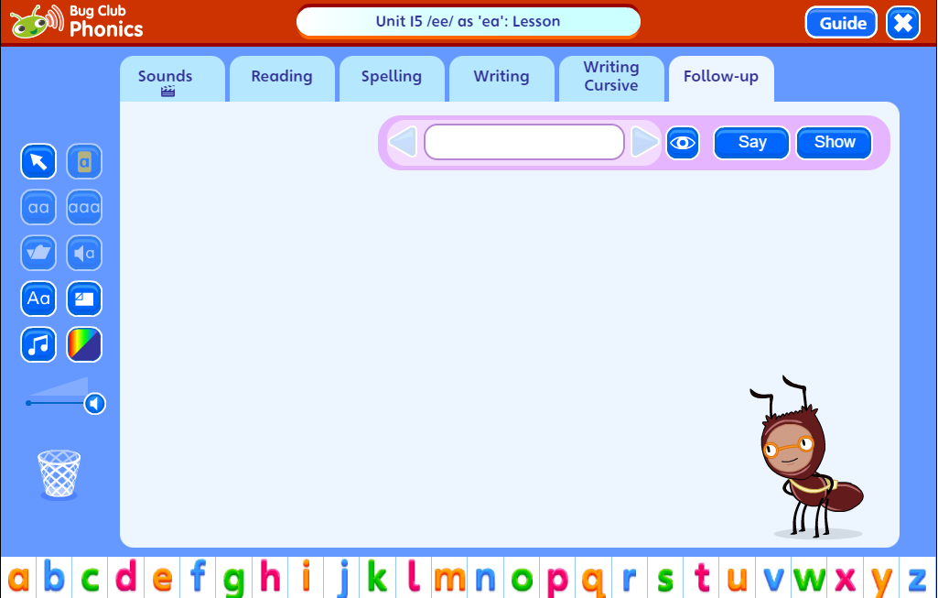
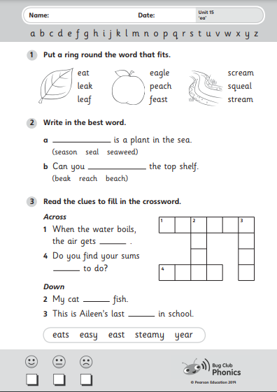
A typical Bug Club lesson
Alphabet song
Revision
Highlighting the phoneme
Blending
Spelling
Writing
Follow up

Slide 15
Phonics Terminology
Phoneme - the smallest unit of sound as it is spoken
Grapheme - a written symbol that represents a sound (phoneme) that's either one letter or a sequence of letters
Digraph - two letters that work together to make the same sound (ch, sh, ph)
Vowel digraph - a digraph in which at least one of the letters is a vowel: boat or day
Consonant digraph - two consonants which can go together: shop or thin.

Slide 16
Phonics Terminology
Split digraph (sometimes called 'magic e') - two letters that work together to make the same sound, separated by another letter in the same word. This enables children to understand the difference in vowel sounds between, for example, grip/gripe, cop/cope, tap/tape
Trigraph - three letters that work together to make the same sound (igh, ore, ear)
Pure sound - it's the skill of pronouncing each letter sound clearly and distinctly without adding additional sounds to the end e.g. 'f' not 'fuh.‘

Slide 17
Phonics Terminology
Blend - this is when you say the individual sounds that make up a word and then merge or blend them together to say the word as used when reading
Segment - it's the opposite of blending as it means splitting a word up into individual sounds when spelling and writing.

Slide 18
Phonics Screening Check
For all Year 1 children
Takes place in June
Tested on normal and ‘alien’ words
All words must be blended
Children are allowed to self correct
Administered individually by Mrs Tite and Mrs Thorn
Historically the pass mark is 32/40 but this is announced after all results have been submitted
Pass or Fail – parents will receive a letter
The children who fail will be offered additional support in school and will resit the test the following year

Slide 19
What can you do at home?
Help your child to complete any Phonics homework they bring home
Encourage your child to use their phonics when they are reading at home
Useful websites: phonicsplay.co.uk
topmarks.co.uk
phonicsbloom.com

Slide 20
Writing Expectations – Reception
Hold a pencil effectively in preparation for fluent writing
Develop the foundations of a handwriting style which is fast, accurate and efficient.
Form lower-case and capital letters correctly.
Spell words by identifying sounds in them and representing the sounds with a letter or letters.
Write simple phrases and sentences that can be read by others.
Use capitals and full stops
Re-read what they have written to check that it makes sense.
(Taken from Development Matters Statements and ELG statements)

Slide 21
Writing Expectations – Year 1
Posture
Capital letters
Lower case letters
Numbers
Handwriting ‘families’
Phonemes
Alphabet
Syllables
-s and –es
Alternative Spellings
-ing –ed –er –est
Oral composition
Recount

Slide 22
Writing Expectations – Year 1
Spaces between words
Using ‘and’
Sentence punctuation
Using suffixes –s –es –ed –er –ing
Prefix un
Developing narrative
Proofreading

Slide 23
Writing Expectations - Year 2
Dictation
Homophones
Spellings
Pencil grip
Spelling suffixes
Contractions
Common exception words
Legible handwriting
Consistency
Joining
Spacing
Sentence types

Slide 24
Writing Expectations – Year 2
Word classes
Tense
Sentence demarcation
Vocabulary
Standard English
Sentence composition
Coordination of clauses
Drafting
Writing narratives
Writing a recount
Writing poetry
Subordination of clauses
Proofreading

Slide 25
Punctuation and Grammar
Terminology taught at Reception:
Word sentence letter capital letter lower case letter
finger space full stop question mark exclamation mark
Terminology taught at Year 1:
Word sentence letter capital letter full stop punctuation singular plural question mark exclamation mark
Terminology taught at Year 2:
Noun noun phrase statement question exclamation command compound suffix adjective adverb verb tense (past and present) apostrophe
comma

Slide 26
What can you do at home?
Full sentences
Talk for writing
Add interest
The man ran to his house.
The tall, young man ran quickly to his large, red house.
Sentence starters
Conjunctions
Complete texts – the more they read the better their vocabulary and writing imagination will be.

Slide 27
Year 2 SPAG Test
Spelling, Punctuation and Grammar
What type of word is underlined in the sentence below?
Poppy held the baby rabbit gently in her arms.
What type of word is brave in the sentence below?
The brave mouse marched up to the lion.
Tick the sentence that is a statement.
What an interesting painting!
Can you collect the crayons, please?
James washed the paintbrushes.
Check that your tables are clean.

Slide 28
Spellings
Key words
Word families – linked to phonics learning
Spelling tests

Slide 29
Speech and Language
Not interrupt when someone is speaking
Respond appropriately
Look at who is speaking and look at the audience when speaking
Speak correctly in full sentences
Concentrate
Be audible
Follow instructions
Talk on various subjects
Show awareness of audience

