Slide 1
Reading at William Ransom School
Once a child has started our reading scheme, they are given a book to read at home with their parents. We strongly encourage the children to read every night and this is recorded in their Reading Records. The Reading Records contain the following guidance for parents on how best to support their child’s reading at home. There is also a list of suggested questions for the parents to deepen their child’s understanding.

Slide 2
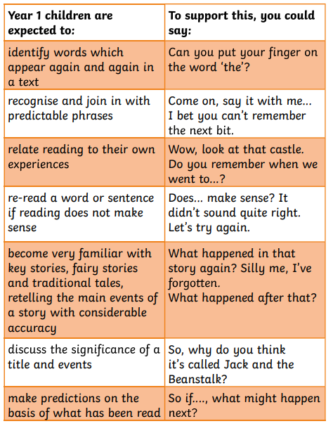
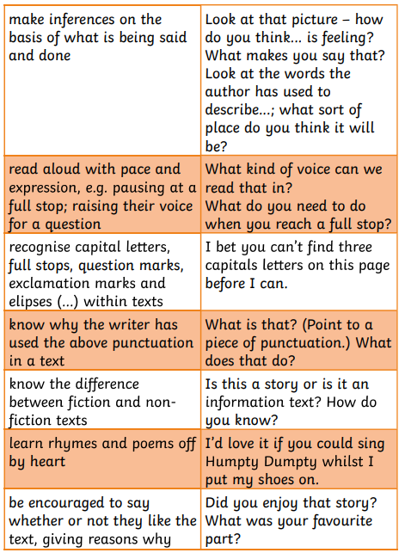
Please listen to your child read and sign this reading record regularly. Here are some ideas to help you support your child.

Slide 3
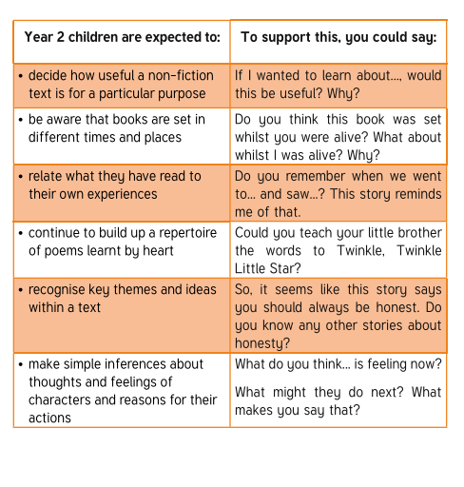
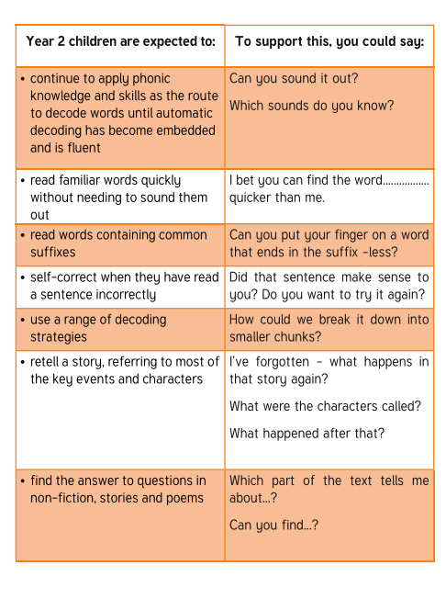
Please listen to your child read and sign this reading record regularly. Here are some ideas to help you support your child.

Slide 4
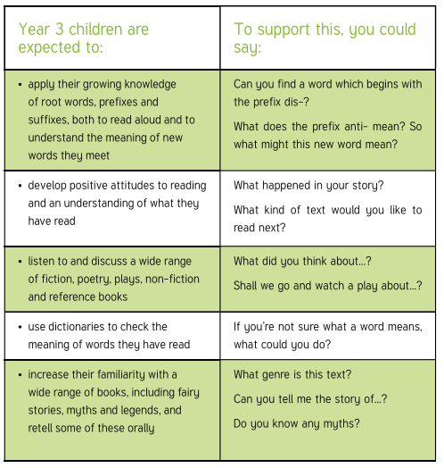
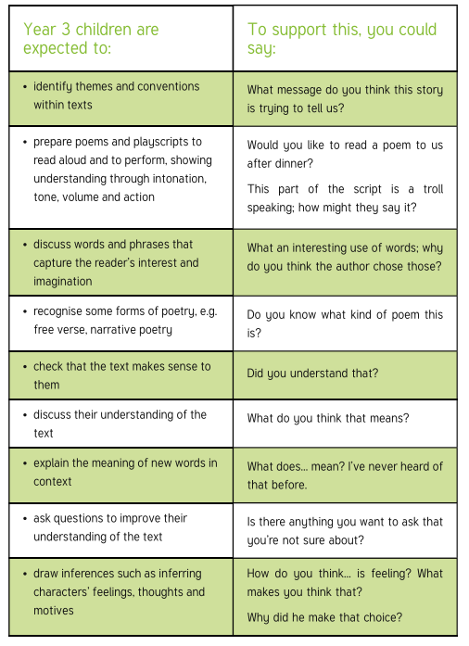
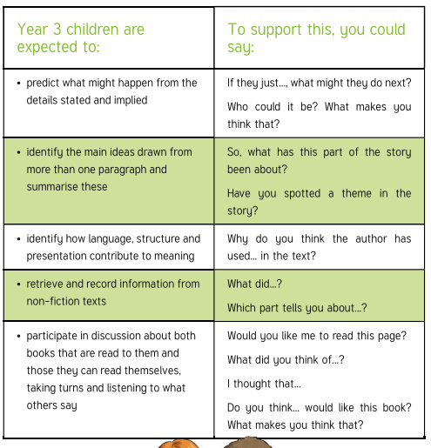
Please listen to your child read and sign this reading record regularly. Here are some ideas to help you support your child.

Slide 5
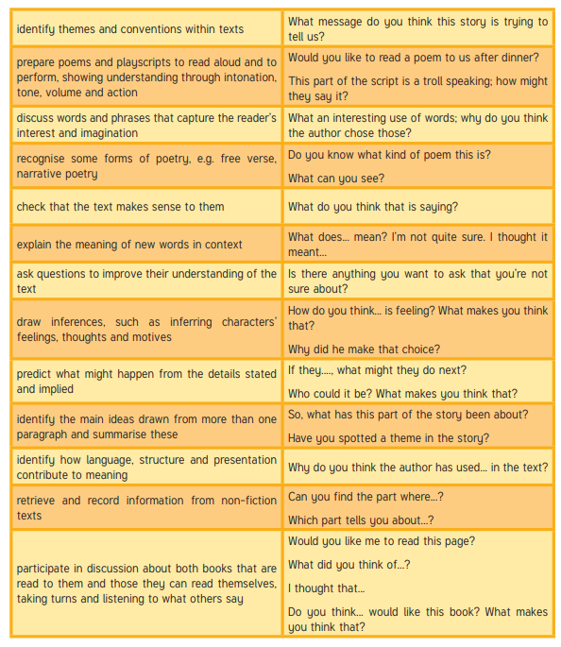
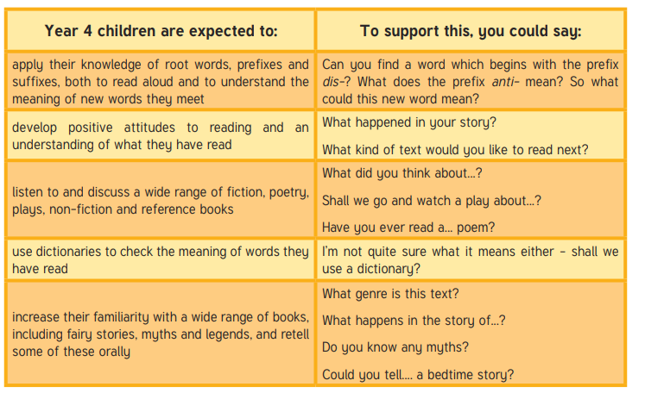
Please listen to your child read and sign this reading record regularly. Here are some ideas to help you support your child.

Slide 6
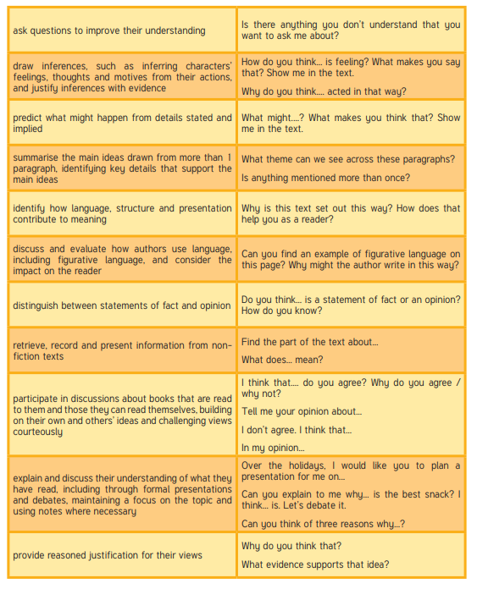
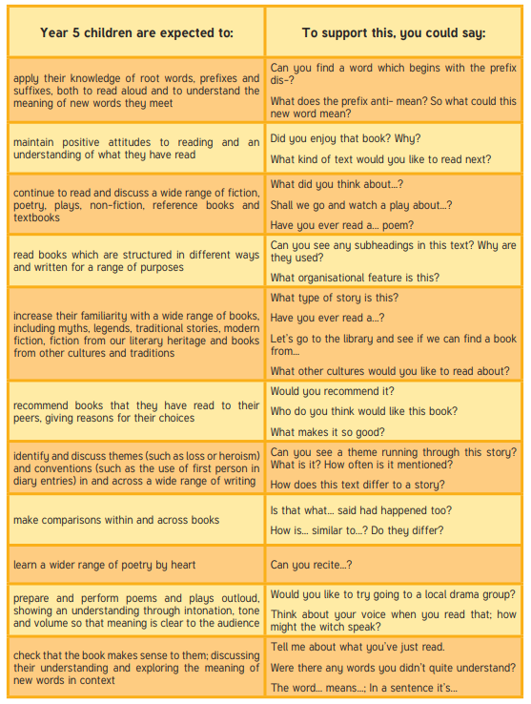
Please listen to your child read and sign this reading record regularly. Here are some ideas to help you support your child.

Slide 7
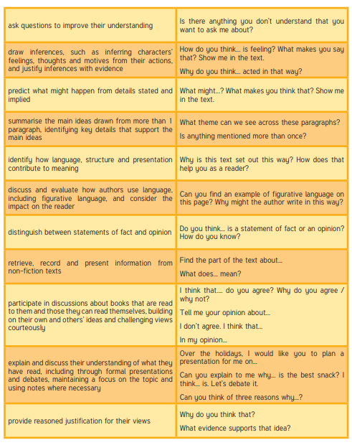
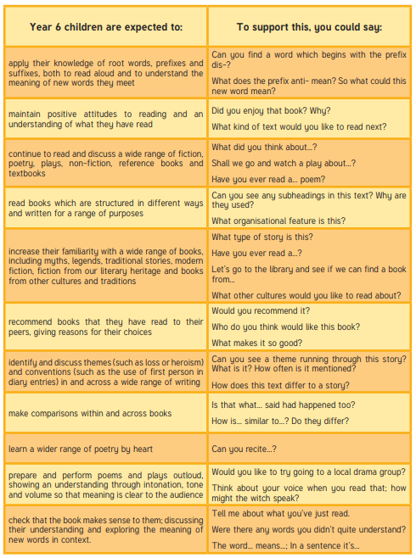
Please listen to your child read and sign this reading record regularly. Here are some ideas to help you support your child.

