Slide 1
Introduction to Year 3 Mrs Bassindale & Mrs Gibson

Slide 2
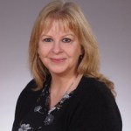
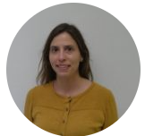
Meet the Teachers
Mrs Bassindale
Elm Class
Mrs Gibson
Maple Class
What can you and your child expect in Year 3?

Slide 3
How is Year 3 different to KS1?
No afternoon break.
Backpacks instead of book bags.
Homework is set online.
No ‘Show and Tell’.
Non-elasticated ties.

Slide 4
What do they need?
PE kit and Art apron
A waterproof coat which must be brought in every day as we go out to play in light rain
Water bottle (plastic, not metal)
Fruit snack for break (optional). This must be fresh fruit, not snack bars.
Backpack. Small backpacks only, please. They only need to be big enough for a reading book, reading record and water bottle.

Slide 5
What do they need?
We provide all stationery therefore children must not bring in pencil cases, colouring pencils, felt tip pens or any other stationery.
Children will write in pencil in the Autumn term. We will issue handwriting pens later in the year.

Slide 6
Independence
We encourage children to develop their independence in Year 3. Please help by:
Ensuring all clothing is labelled, especially jumpers/cardigans and PE kits.
Ensuring water bottles and snack boxes are named.
Ensuring children can dress and undress independently: this includes fastening shirt buttons, ties and shoelaces.

Slide 7
Reading
Children should read to an adult at least 4-5 times a week. This should be recorded in their reading records and signed by an adult.
Reading records are collected weekly so that we can monitor how frequently children are reading to an adult.
Adults should question their comprehension of the text and encourage them to be aware of what they are reading at both sentence and whole text level.

Slide 8
Homework
Homework is set online every Friday and handed in the following Thursday.
English is set on Google Classroom and will be linked to the work completed in class.
Spellings follow a specific pattern or set of key words. These are also set on Google Classroom.

Slide 9
Homework
Maths is set online via MyMaths and will be linked to the work completed in class. Log-ins will be sent out at the beginning of term.
Children are set Times Tables which they practise using Times Tables Rockstars. Times tables are personalised and children must be secure on each before moving on to the next. Log-ins will be sent out at the beginning of term.

Slide 10
Homework Guidance
Homework should take around 20-30 minutes per evening to complete
Encourage the children to set themselves high standards and stretch themselves
We are happy for you to support your children if they find a particular concept tricky but you should not have to do the work for them

Slide 11
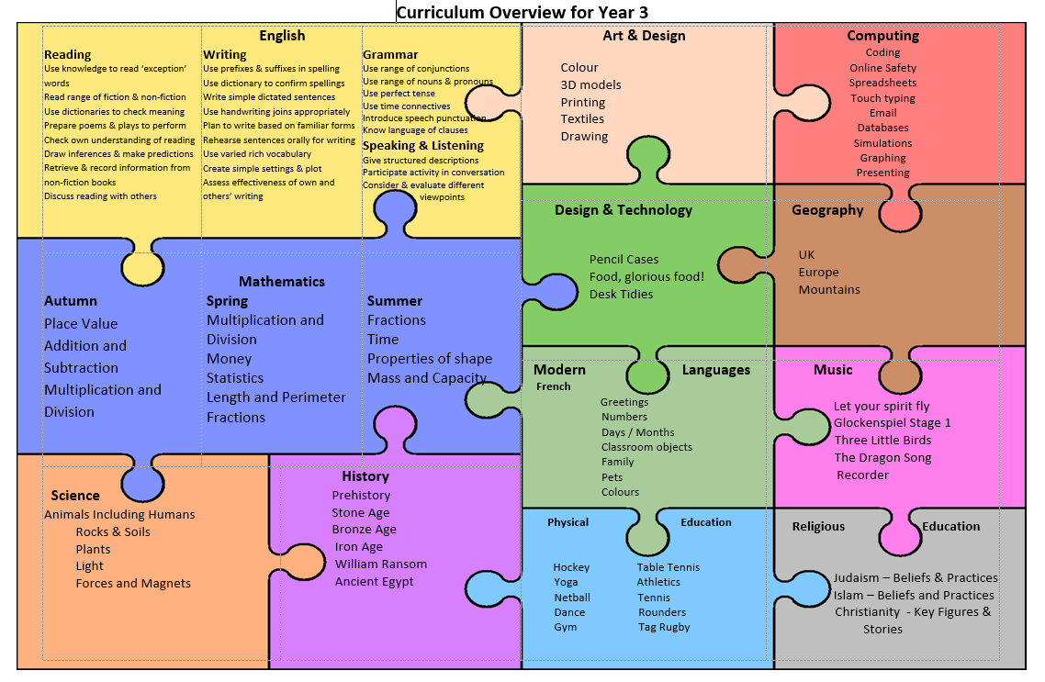
Curriculum
Here is an overview of the topics covered in each subject in Year 3. This is also available on the website.

Slide 12
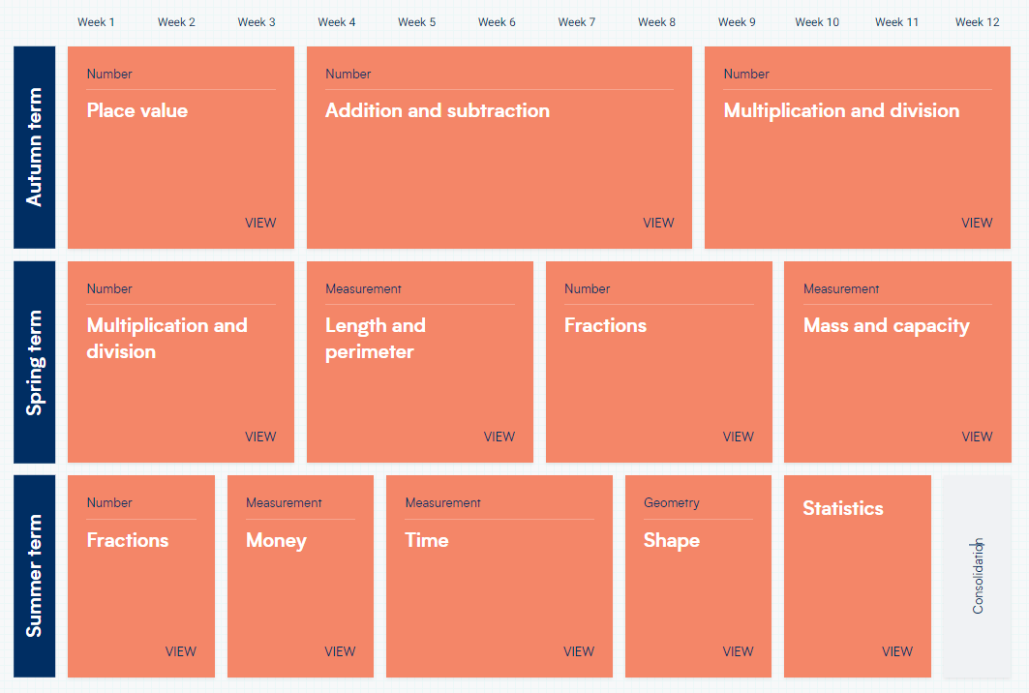
Maths
Here is an overview of the topics covered in Maths throughout the year.

Slide 13
Maths
We set for Maths so your child will be in a group of mixed Elm & Maple children.
Children may move between the groups according to their individual strengths and weaknesses across different topics.
We swap the groups when we change topic so all children will have opportunities to be taught by both Mrs Bassindale and Mrs Gibson.

Slide 14
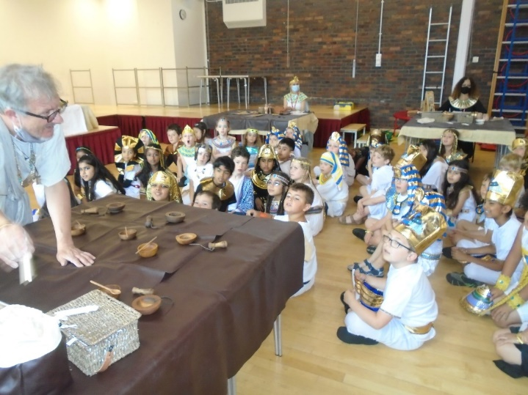
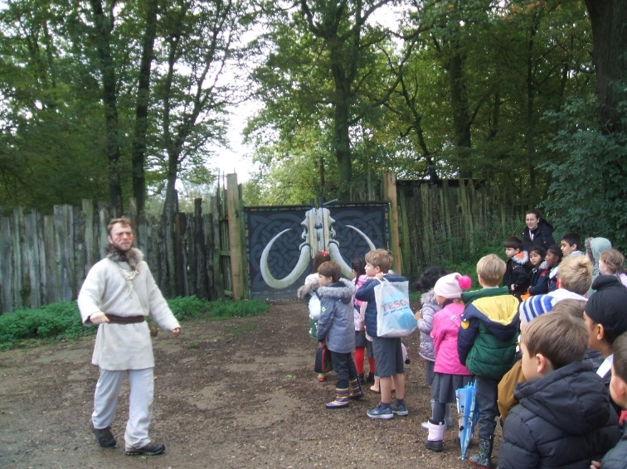
Visits
The children will have the opportunity to participate in a range of trips and experiences whilst in Year 3.
Last year we visited Celtic Harmony to experience life in the Stone Age and Iron Age.
We also enjoyed an Ancient Egyptian experience day in school.

Slide 15
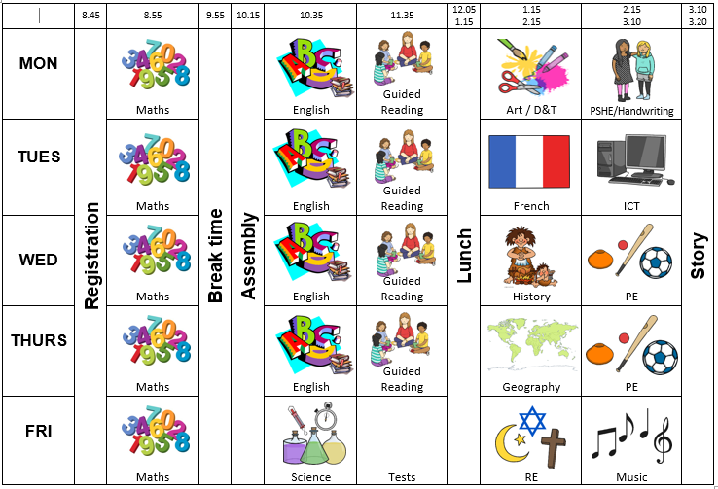
Timetable
This is an example of a typical Year 3 timetable. Timetables for each class will be issued at the beginning of the term.

Slide 16
Please do not hesitate to contact us if you have any questions. b.bassindale@wransom.herts.sch.uk a.gibson@wransom.herts.sch.uk

